Slide 1

Information search: Accessing Databases with JDBC
CS 469 / CS 569: Special Topics in Computer Science: Human-Computer Interaction
Dr. Mohammed Ayoub Alaoui Mhamdi
Bishop's University
Sherbrooke, Qc, Canada
malaoui@ubishops.ca

Slide 2
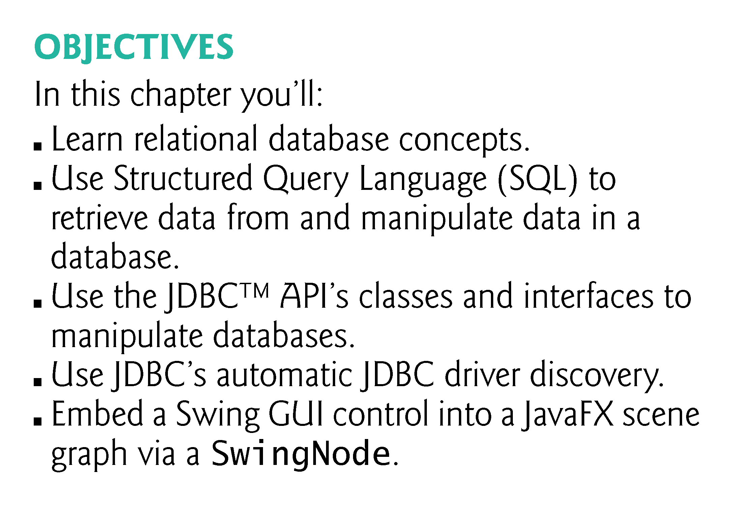

Slide 3
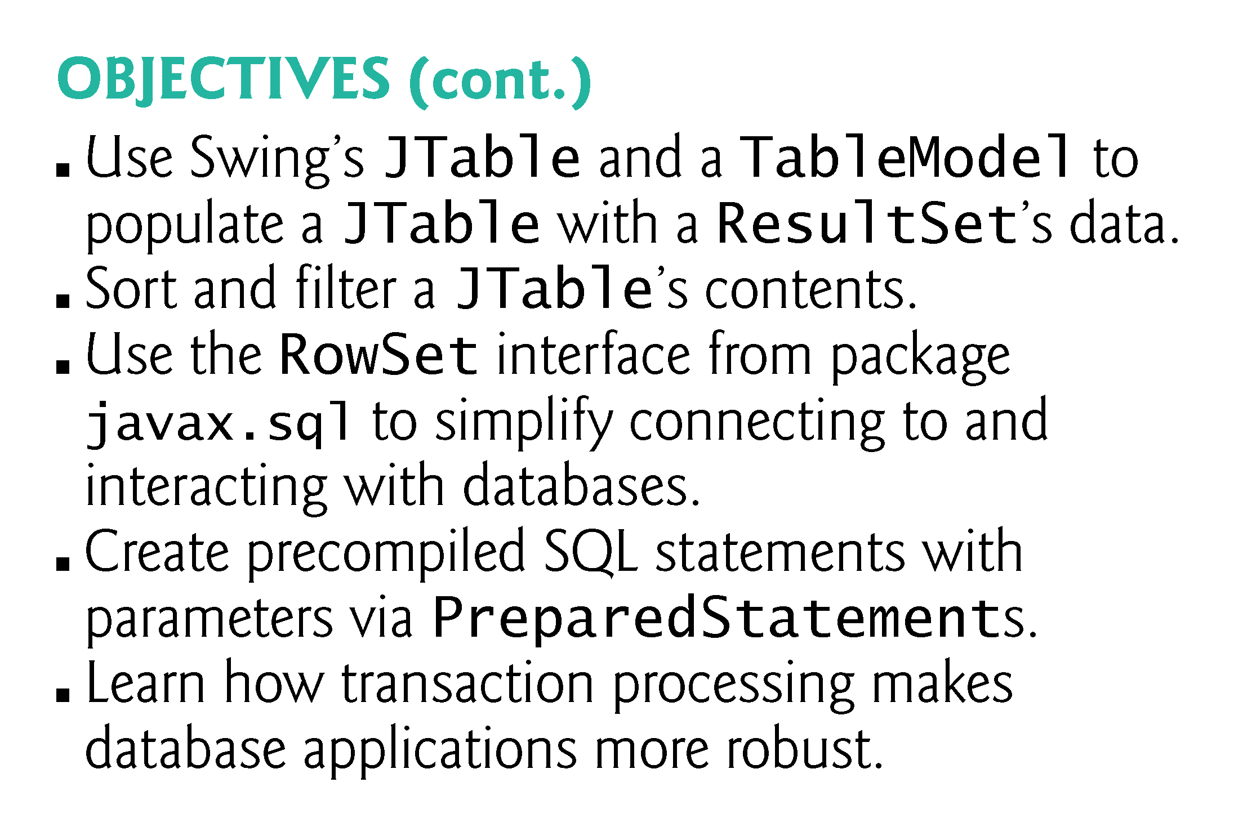

Slide 4
Introduction
A database is an organized collection of data.
A database management system (DBMS) provides mechanisms for storing, organizing, retrieving and modifying data for many users.
SQL is the international standard language used with relational databases to perform queries and to manipulate data.
Popular relational database management systems (RDBMSs)
Microsoft SQL Server, Oracle, Sybase and IBM DB2, PostgreSQL, MariaDB and MySQL

Slide 5
Introduction (cont.)
Java programs interact with databases using the Java Database Connectivity (JDBC™) API.
A JDBC driver enables Java applications to connect to a database in a particular DBMS and allows you to manipulate that database using the JDBC API.

Slide 6
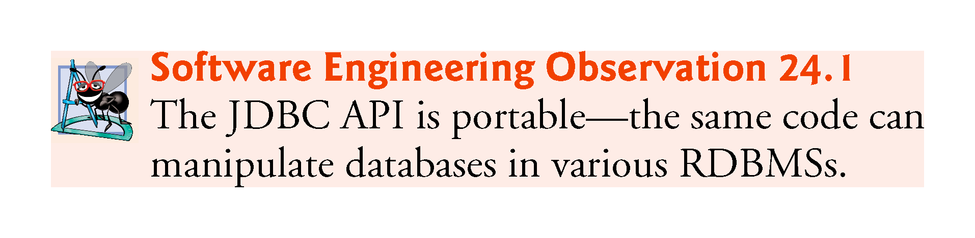

Slide 7
Introduction (cont.)
Java Persistence API (JPA)
In that chapter, you’ll learn how to autogenerate Java classes that represent the tables in a database and the relationships between them—known as object-relational mapping—then use objects of those classes to interact with a database.
As you’ll see, storing data in and retrieving data from a database will be handled for you—the techniques you learn in this chapter will typically be hidden from you by JPA.

Slide 8
Relational Databases
A relational database is a logical representation of data that allows the data to be accessed without consideration of its physical structure.
A relational database stores data in tables.
Tables are composed of rows, each describing a single entity—in Fig. 24.1, an employee.
Rows are composed of columns in which values are stored.
Primary key—a column (or group of columns) with a value that is unique for each row.

Slide 9
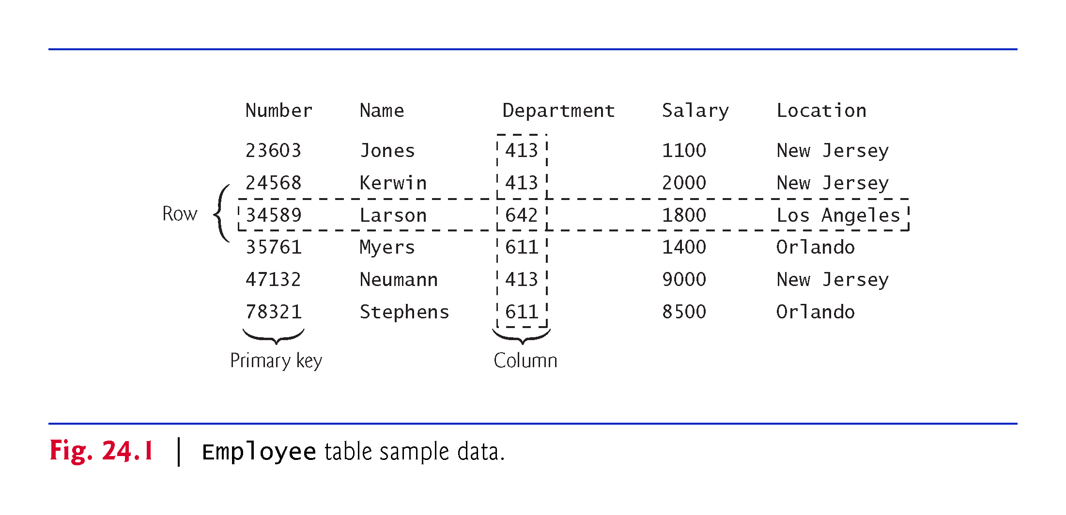

Slide 10
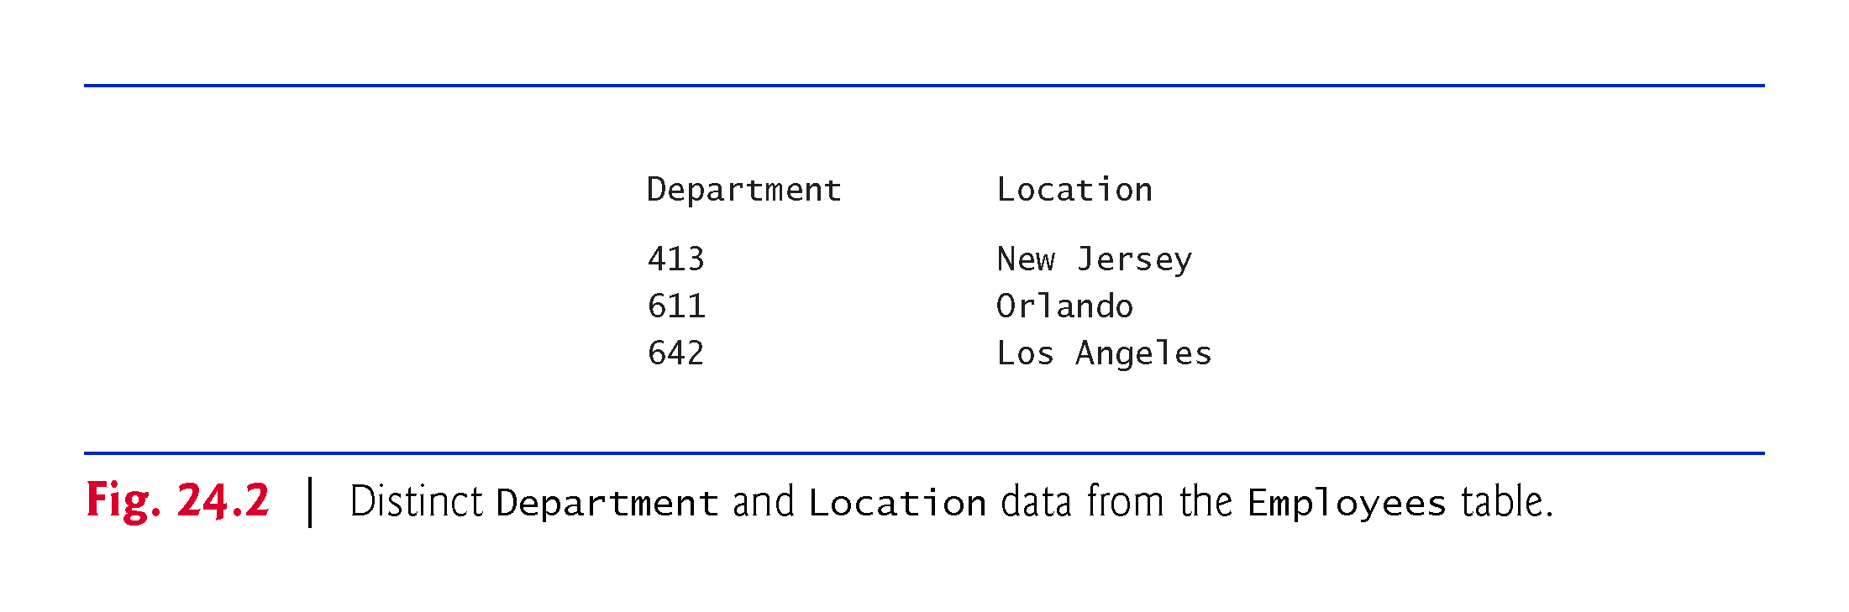

Slide 11
A books Database
We introduce relational databases in the context of this chapter’s books database, which you’ll use in several examples.
The database consists of three tables: Authors, AuthorISBN and Titles.
AuthorISBN table consists of two columns that maintain ISBNs for each book and their corresponding authors’ ID numbers.
The AuthorID column is a foreign key—a column in this table that matches the primary-key column in another table.
Every foreign-key value must appear as another table’s primary-key value so the DBMS can ensure that the foreign key value is valid—this is known as the Rule of Referential Integrity.
There is a one-to-many relationship between a primary key and a corresponding foreign key.

Slide 12
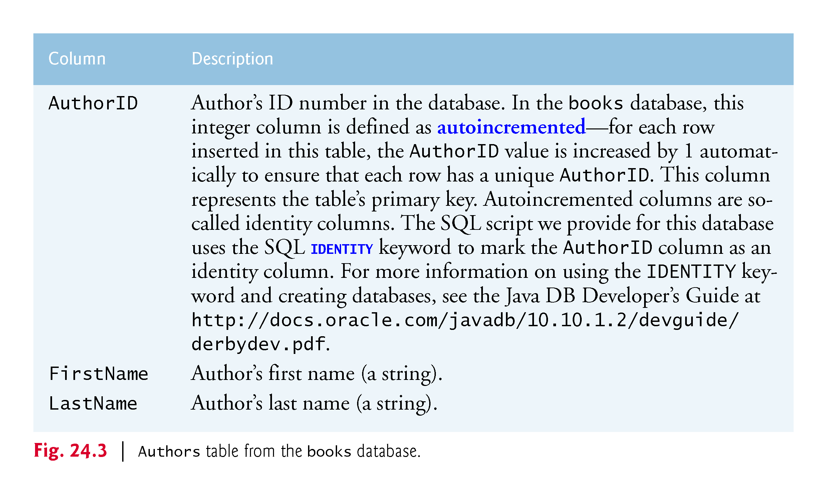

Slide 13
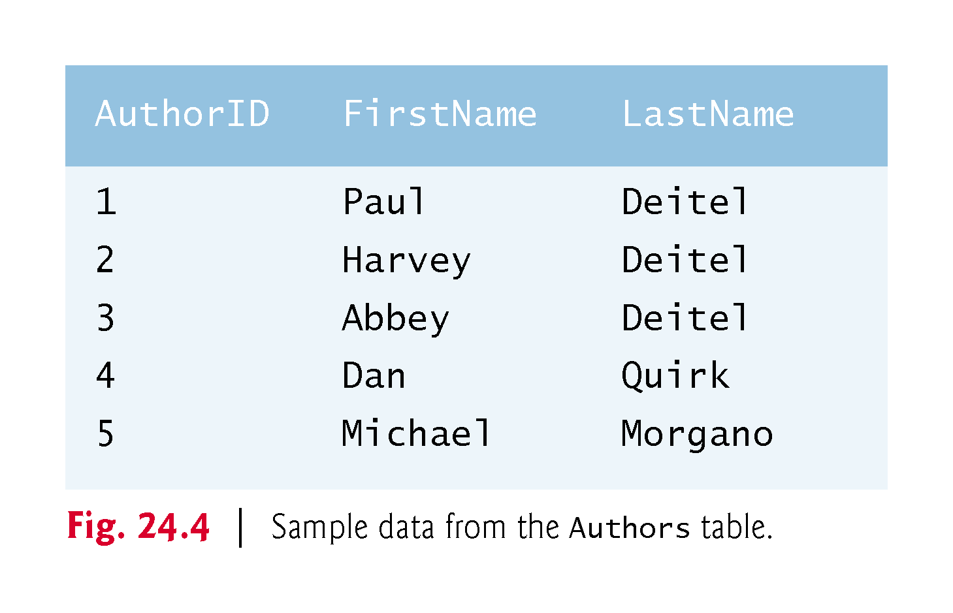

Slide 14
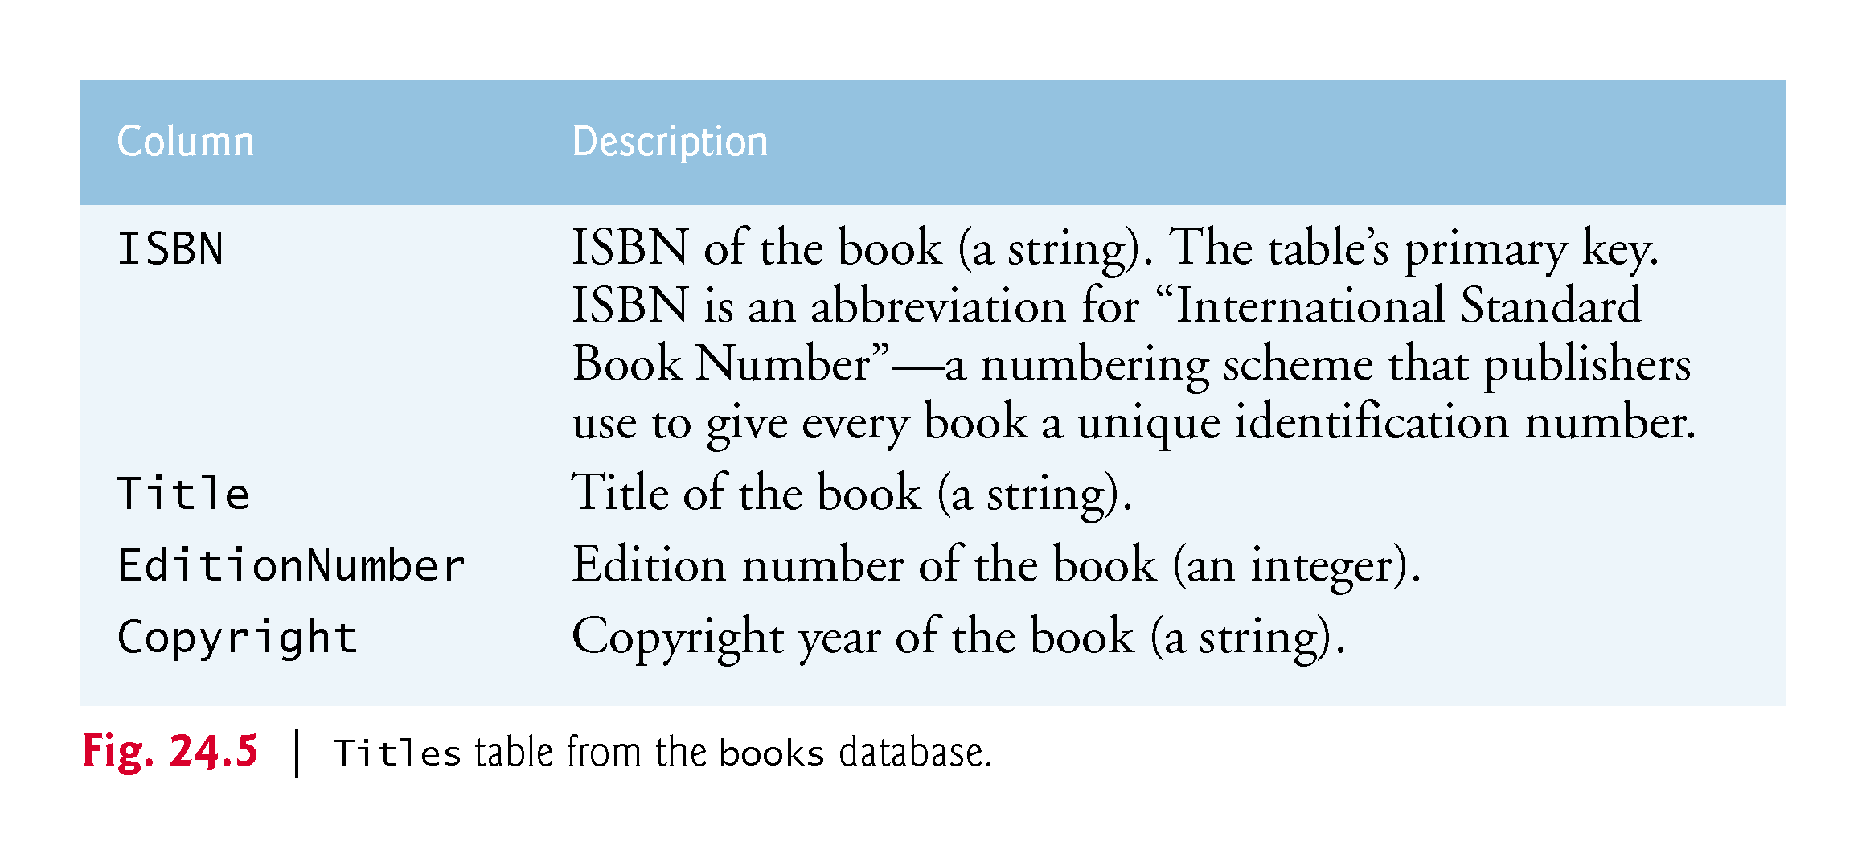

Slide 15
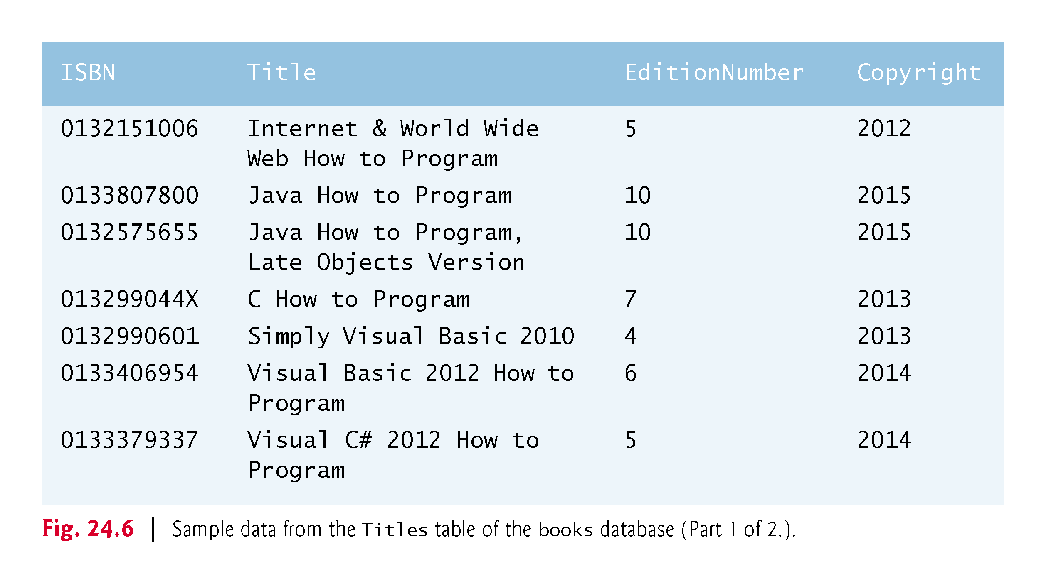

Slide 16
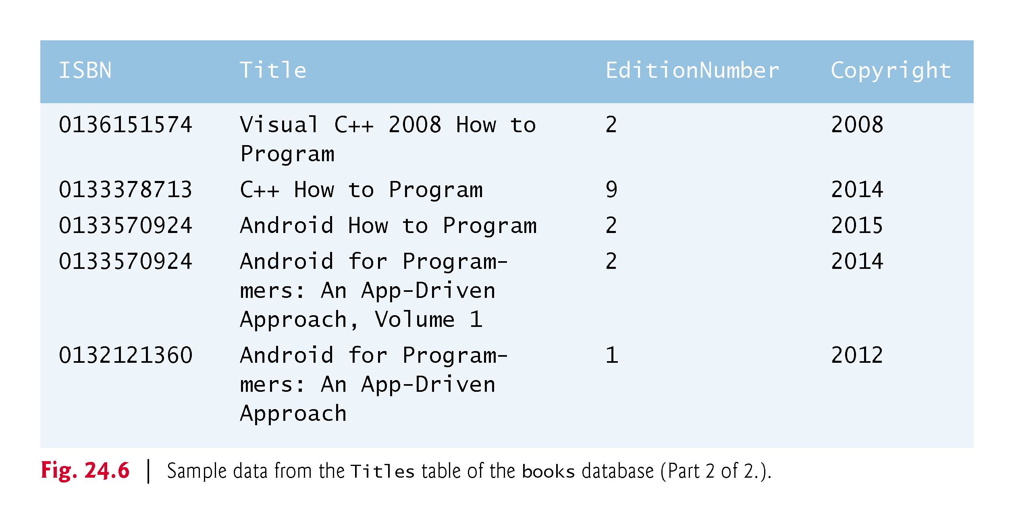

Slide 17
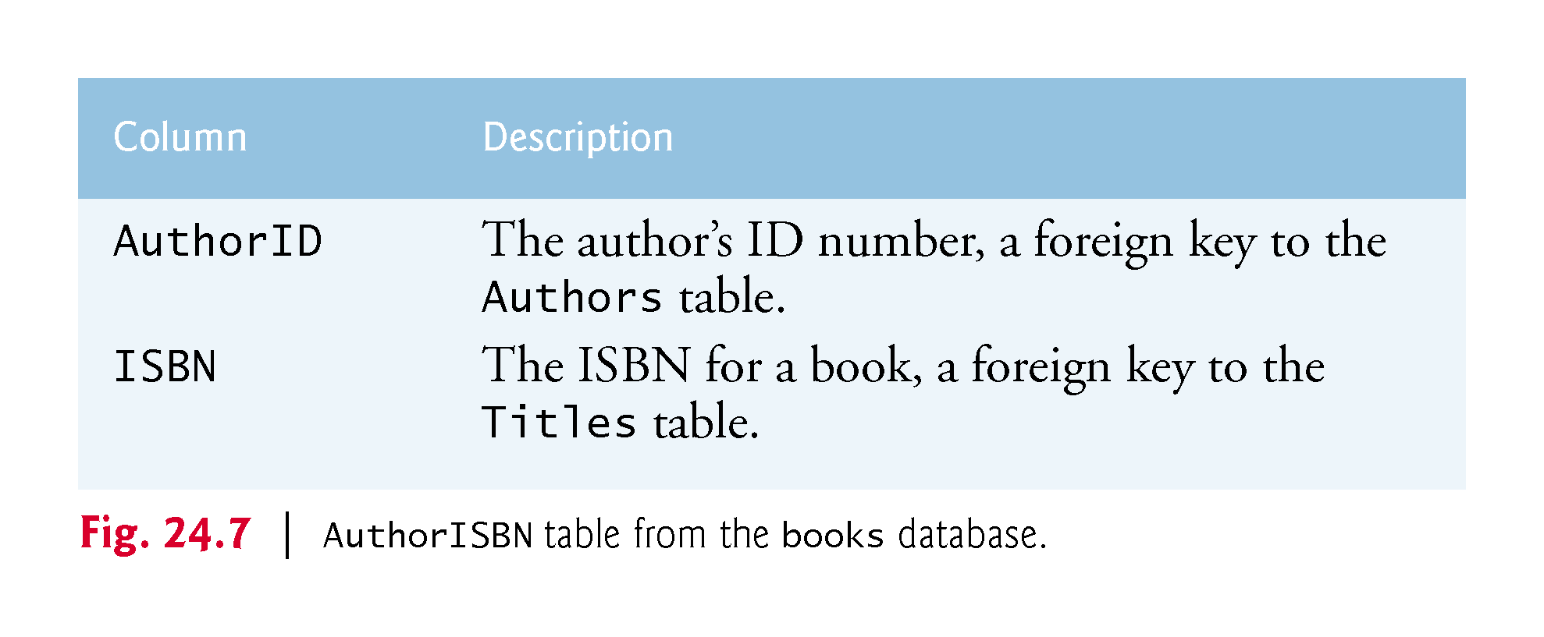

Slide 18
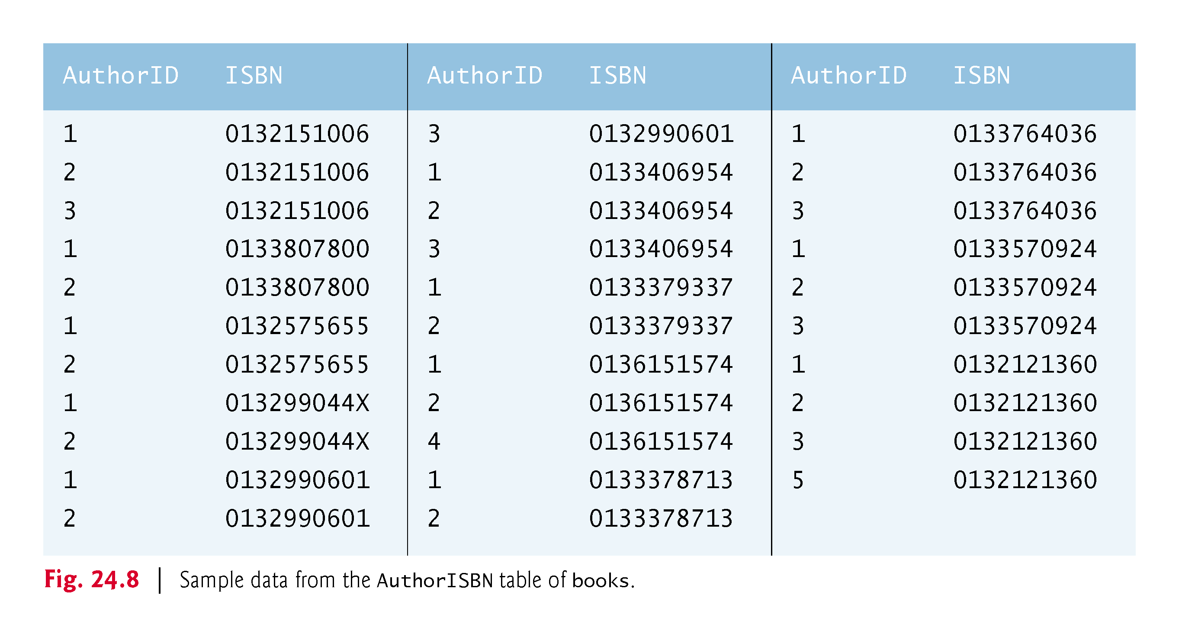

Slide 19
A books Database (cont.)
Entity-relationship (ER) diagram for the books database.
Shows the database tables and the relationships among them.
The names in italic are primary keys.
A table’s primary key uniquely identifies each row in the table.
Every row must have a primary-key value, and that value must be unique in the table.
This is known as the Rule of Entity Integrity.

Slide 20
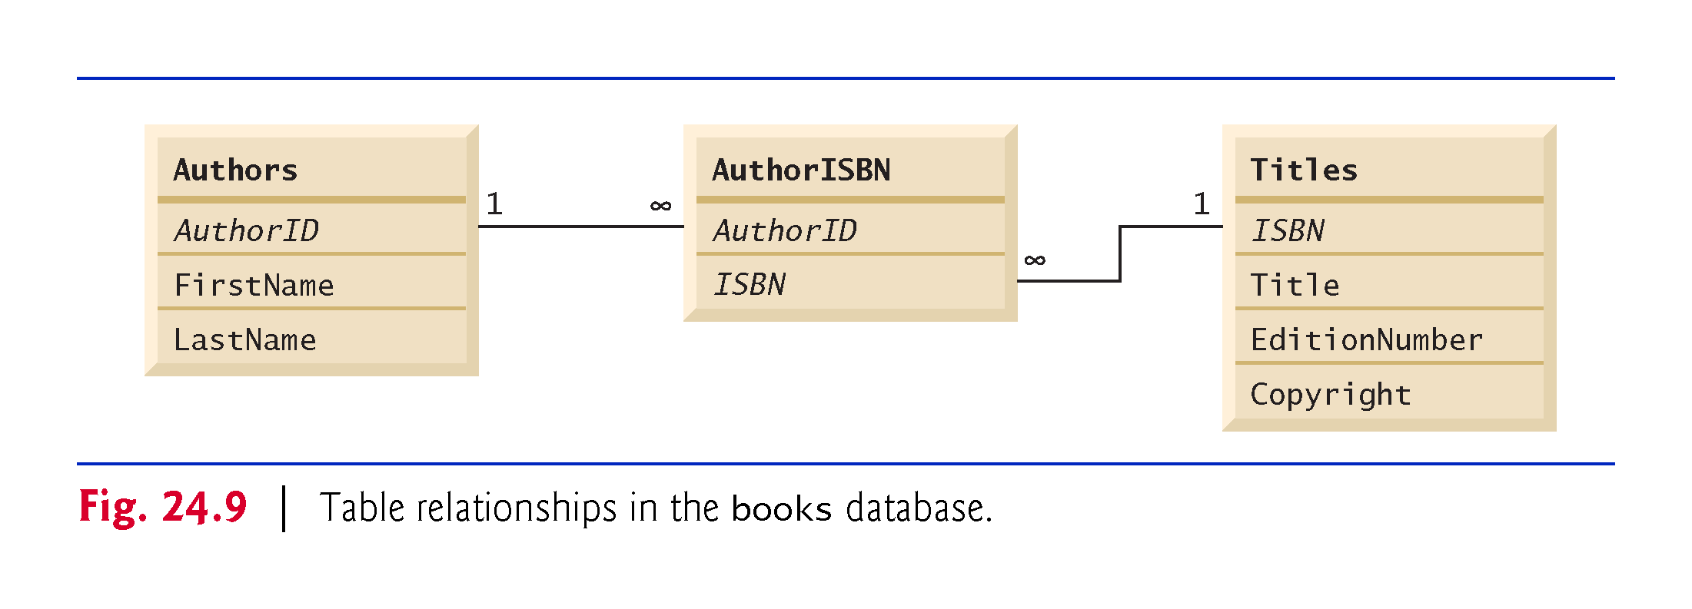

Slide 21
SQL
The next several subsections discuss the SQL queries and statements using the SQL keywords.
Other SQL keywords are beyond this text’s scope.

Slide 22
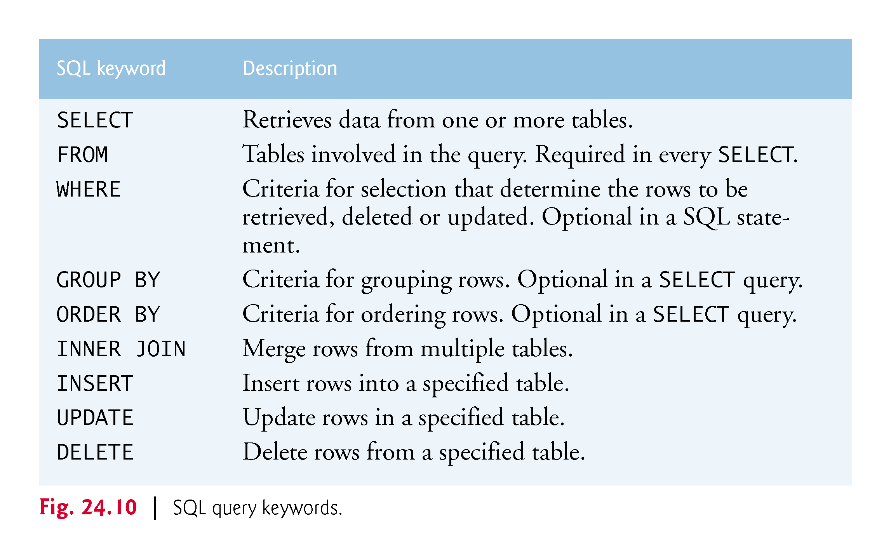

Slide 23
Basic SELECT Query
A SQL query “selects” rows and columns from one or more tables in a database.
The basic form of a SELECT query is
SELECT * FROM tableName
in which the asterisk (*) wildcard character indicates that all columns from the tableName table should be retrieved.
To retrieve all the data in the Authors table, use
SELECT * FROM Authors
To retrieve only specific columns, replace the asterisk (*) with a comma-separated list of the column names, e.g.,
SELECT AuthorID, LastName FROM Authors

Slide 24
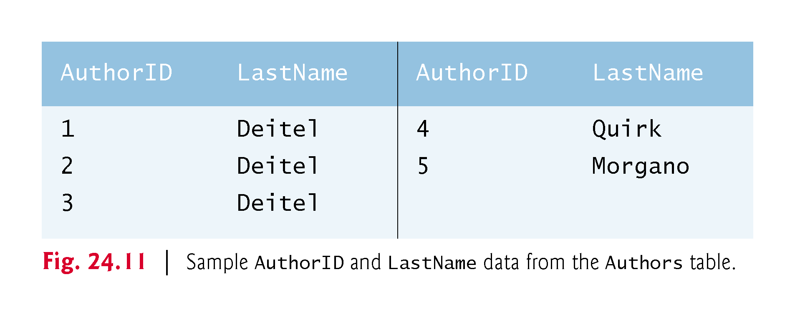

Slide 25
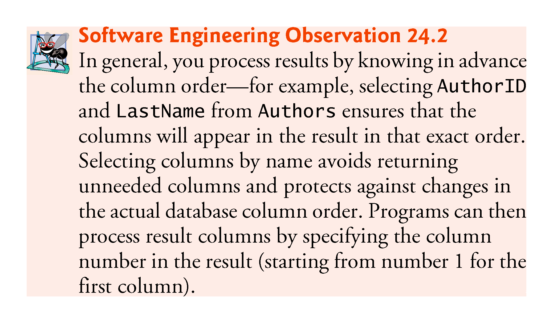

Slide 26
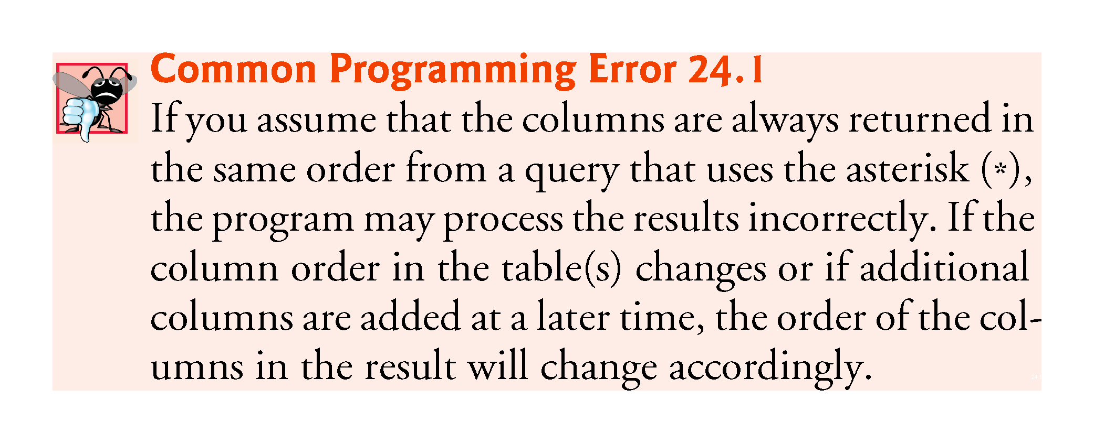

Slide 27
WHERE Clause
In most cases, only rows that satisfy selection criteria are selected.
SQL uses the optional WHERE clause in a query to specify the selection criteria for the query.
The basic form of a query with selection criteria is
SELECT columnName1, columnName2, … FROM tableName WHERE criteria
To select the Title, EditionNumber and Copyright columns from table Titles for which the Copyright date is greater than 2013, use the query
SELECT Title, EditionNumber, Copyright FROM Titles WHERE Copyright > '2013'
Strings in SQL are delimited by single (') rather than double (") quotes.
The WHERE clause criteria can contain the operators <, >, <=, >=, =, <> and LIKE.

Slide 28
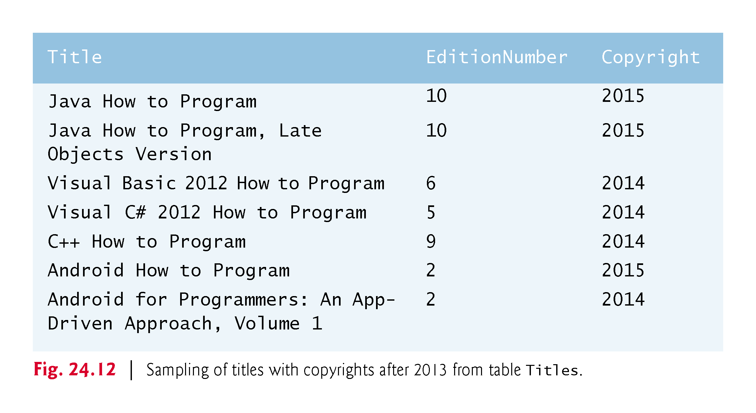

Slide 29
WHERE Clause (cont.)
Operator LIKE is used for pattern matching with wildcard characters percent (%) and underscore (_).
A pattern that contains a percent character (%) searches for strings that have zero or more characters at the percent character’s position in the pattern.
For example, the next query locates the rows of all the authors whose last name starts with the letter D:
SELECT AuthorID, FirstName, LastName FROM Authors WHERE LastName LIKE 'D%'

Slide 30
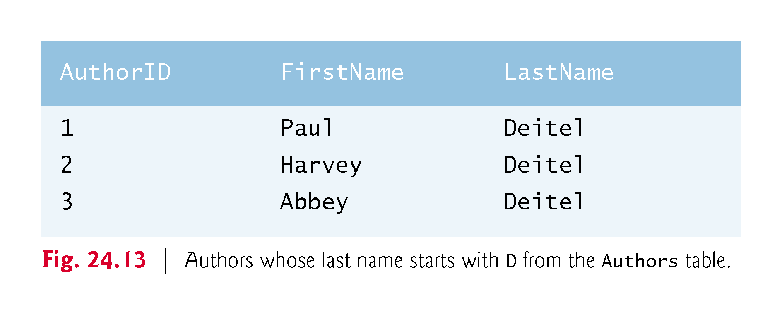

Slide 31
WHERE Clause (cont.)
An underscore ( _ ) in the LIKE pattern string indicates a single wildcard character at that position in the pattern.
The following query locates the rows of all the authors whose last names start with any character (specified by _), followed by the letter o, followed by any number of additional characters (specified by %):
SELECT AuthorID, FirstName, LastName FROM Authors WHERE LastName LIKE '_o%'

Slide 32
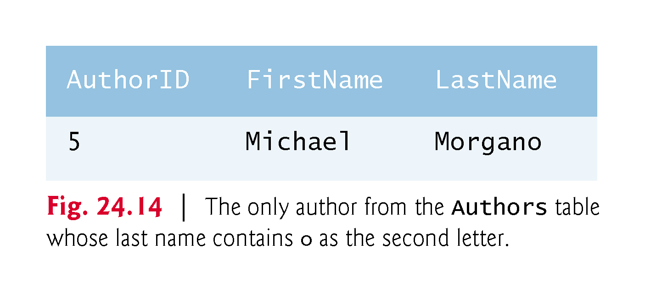

Slide 33
ORDER BY Clause
The rows in the result of a query can be sorted into ascending or descending order by using the optional ORDER BY clause.
The basic form of a query with an ORDER BY clause is
SELECT columnName1, columnName2, … FROM tableName ORDER BY column ASC SELECT columnName1, columnName2, … FROM tableName ORDER BY column DESC
ASC specifies ascending order (lowest to highest)
DESC specifies descending order (highest to lowest)
column specifies the column on which the sort is based.

Slide 34
ORDER BY Clause (cont.)
To obtain the list of authors in ascending order by last name (), use the query
SELECT AuthorID, FirstName, LastName FROM Authors ORDER BY LastName ASC
To obtain the same list of authors in descending order by last name (), use the query
SELECT AuthorID, FirstName, LastName FROM Authors ORDER BY LastName DESC
Multiple columns can be used for sorting with an ORDER BY clause of the form
ORDER BY column1 sortingOrder, column2 sortingOrder, …
sortingOrder is either ASC or DESC.
Sort all the rows in ascending order by last name, then by first name.
SELECT AuthorID, FirstName, LastName FROM Authors ORDER BY LastName, FirstName

Slide 35
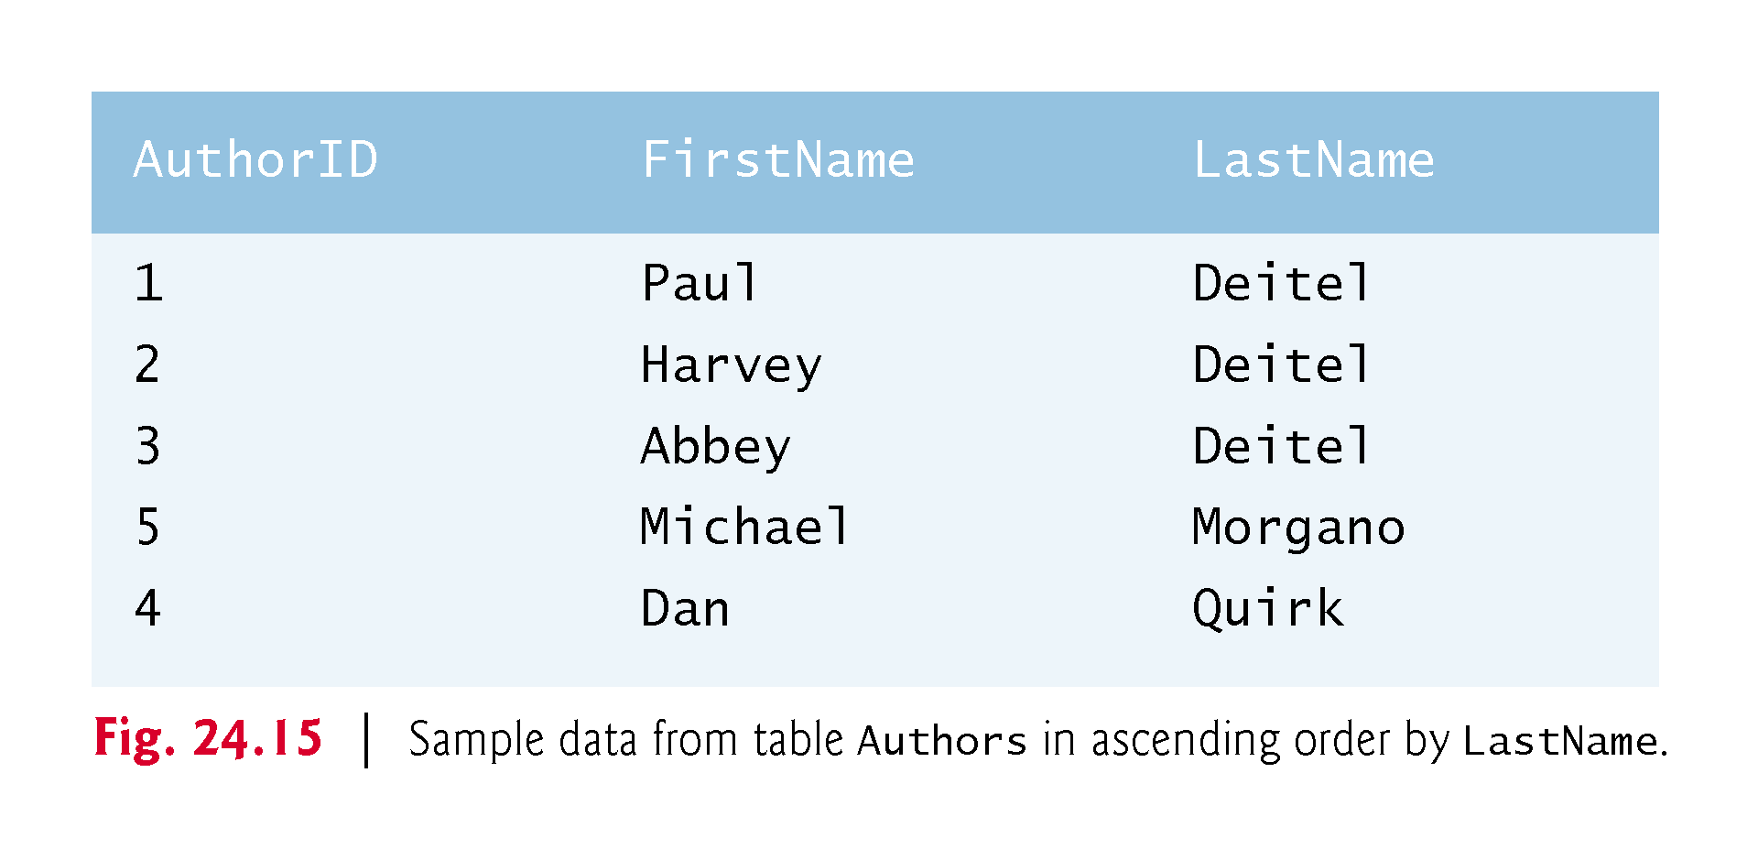

Slide 36
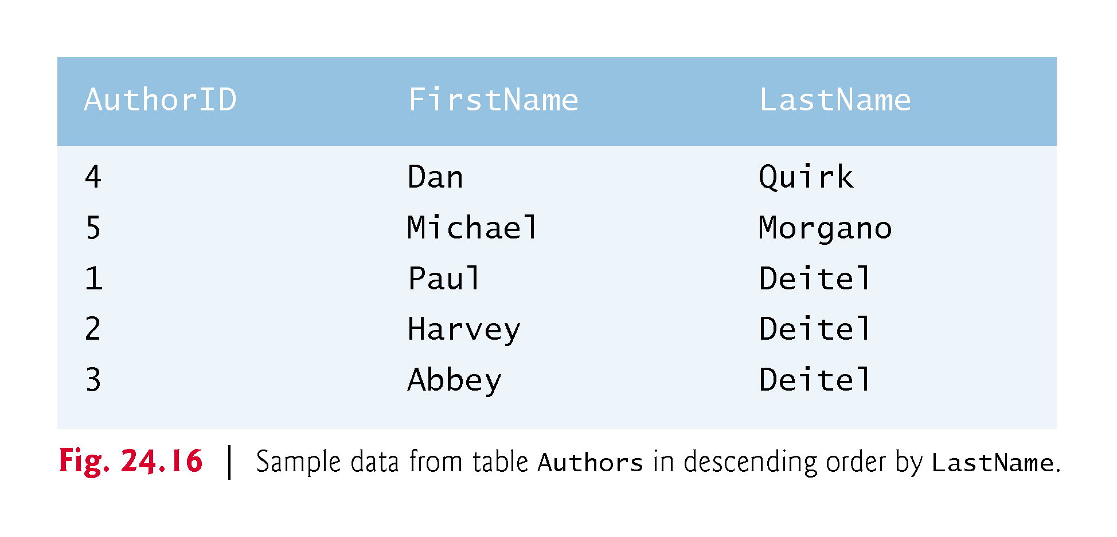

Slide 37
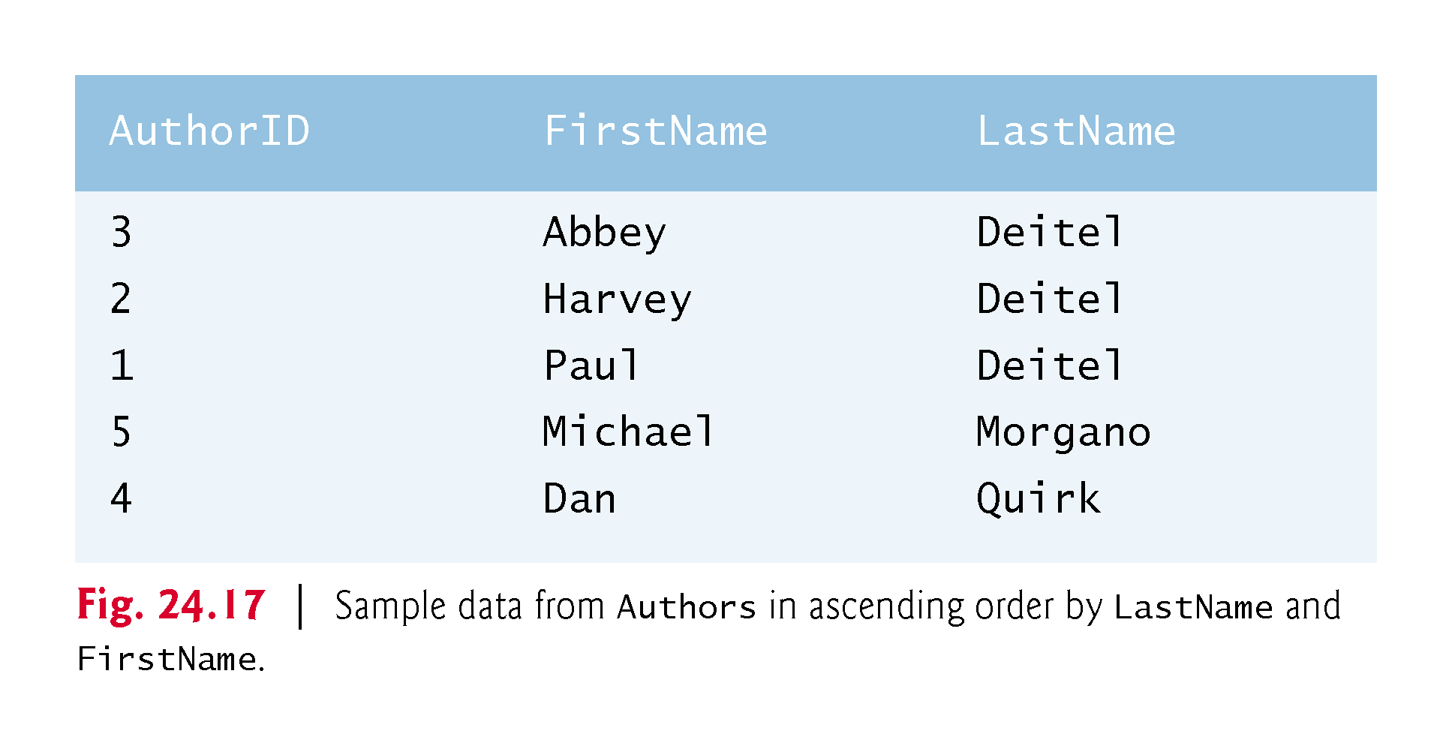

Slide 38
ORDER BY Clause (cont.)
The WHERE and ORDER BY clauses can be combined in one query, as in
SELECT ISBN, Title, EditionNumber, Copyright FROM Titles WHERE Title LIKE '%How to Program' ORDER BY Title ASC
which returns the ISBN, Title, EditionNumber and Copyright of each book in the Titles table that has a Title ending with "How to Program" and sorts them in ascending order by Title.

Slide 39
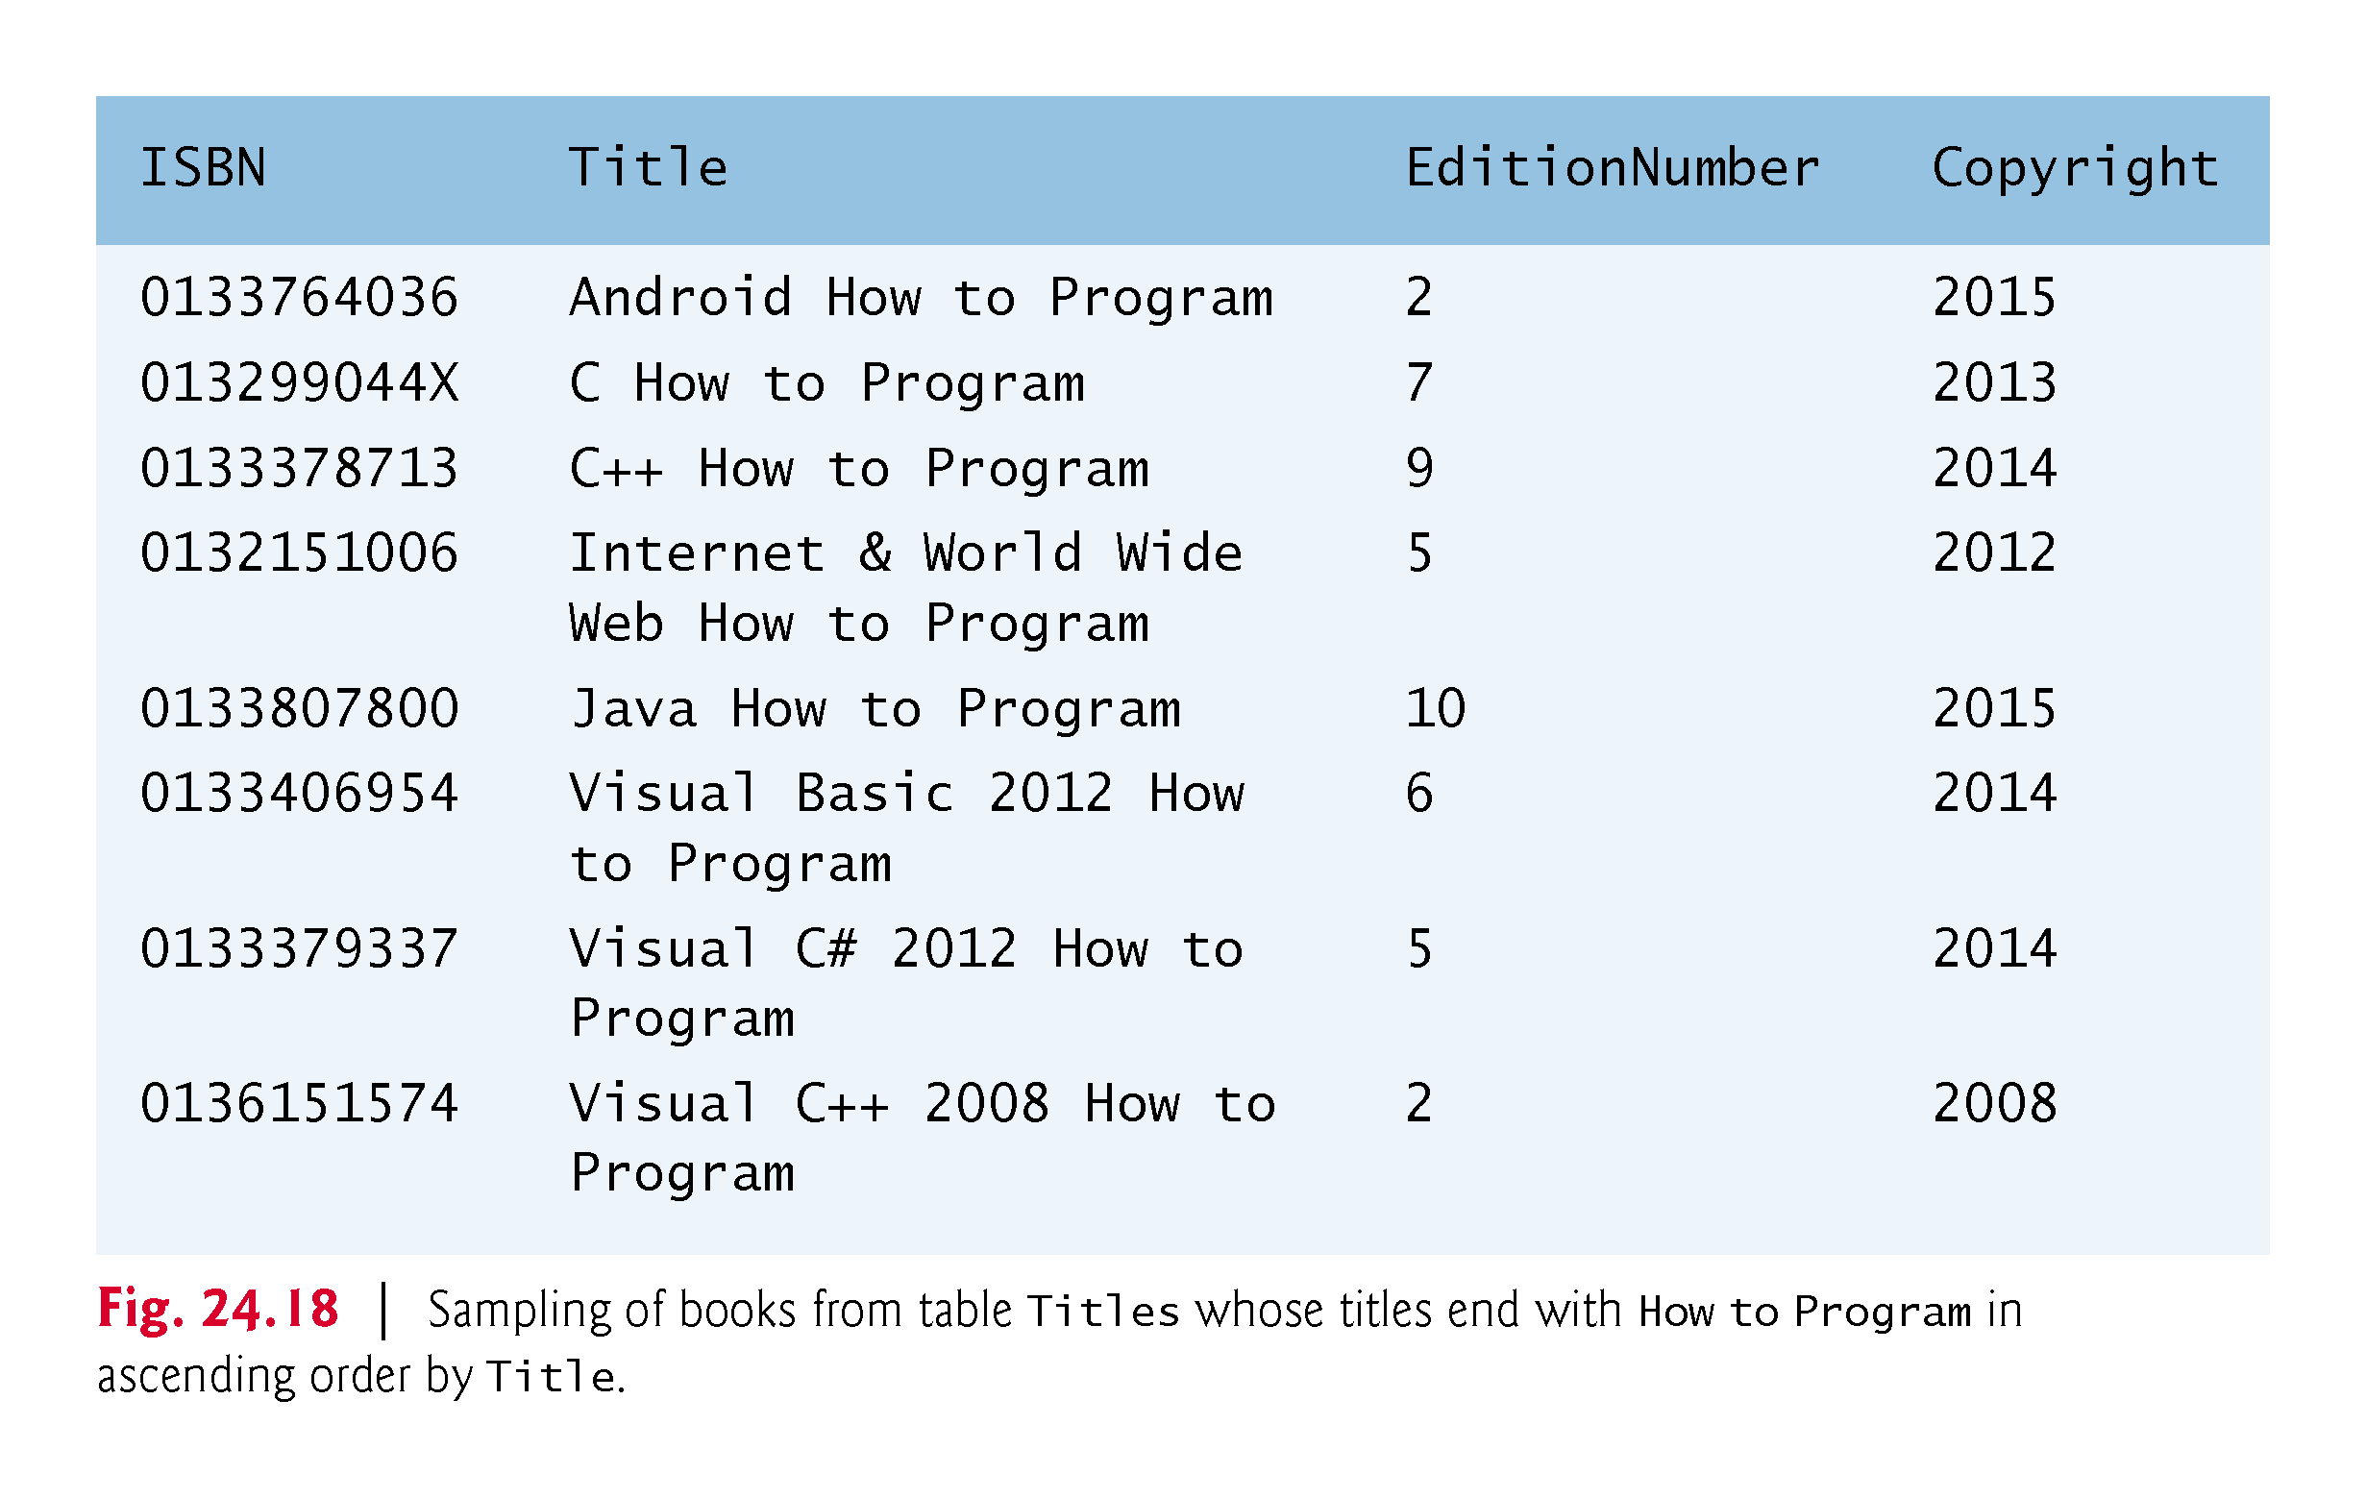

Slide 40
INSERT Statement
The INSERT statement inserts a row into a table.
INSERT INTO tableName (columnName1, columnName2, …, columnNameN) VALUES (value1, value2, …, valueN)
where tableName is the table in which to insert the row.
tableName is followed by a comma-separated list of column names in parentheses
not required if the INSERT operation specifies a value for every column of the table in the correct order
The list of column names is followed by the SQL keyword VALUES and a comma-separated list of values in parentheses.
The values specified here must match the columns specified after the table name in both order and type.

Slide 41
INSERT Statement (cont.)
The INSERT statement
INSERT INTO Authors (FirstName, LastName) VALUES ('Sue', ‘Red')
indicates that values are provided for the FirstName and LastName columns. The corresponding values are 'Sue' and ‘Red'.
We do not specify an AuthorID in this example because AuthorID is an autoincremented column in the Authors table.
Not every database management system supports autoincremented columns.

Slide 42
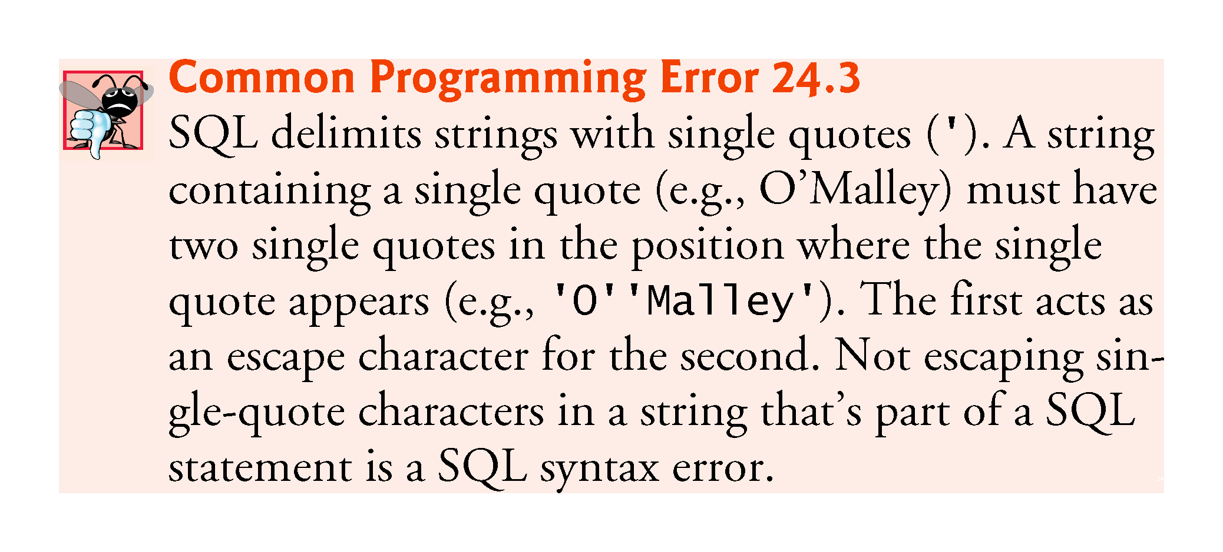

Slide 43
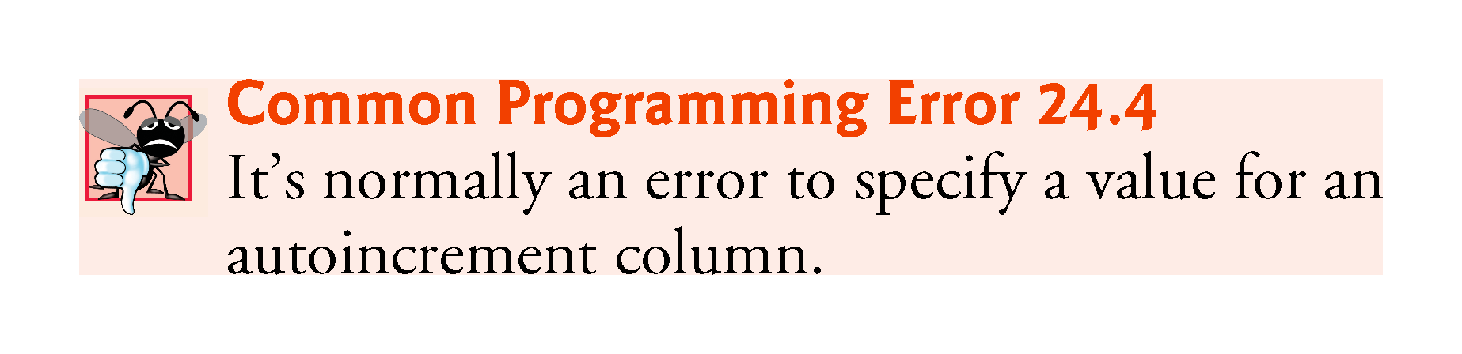

Slide 44
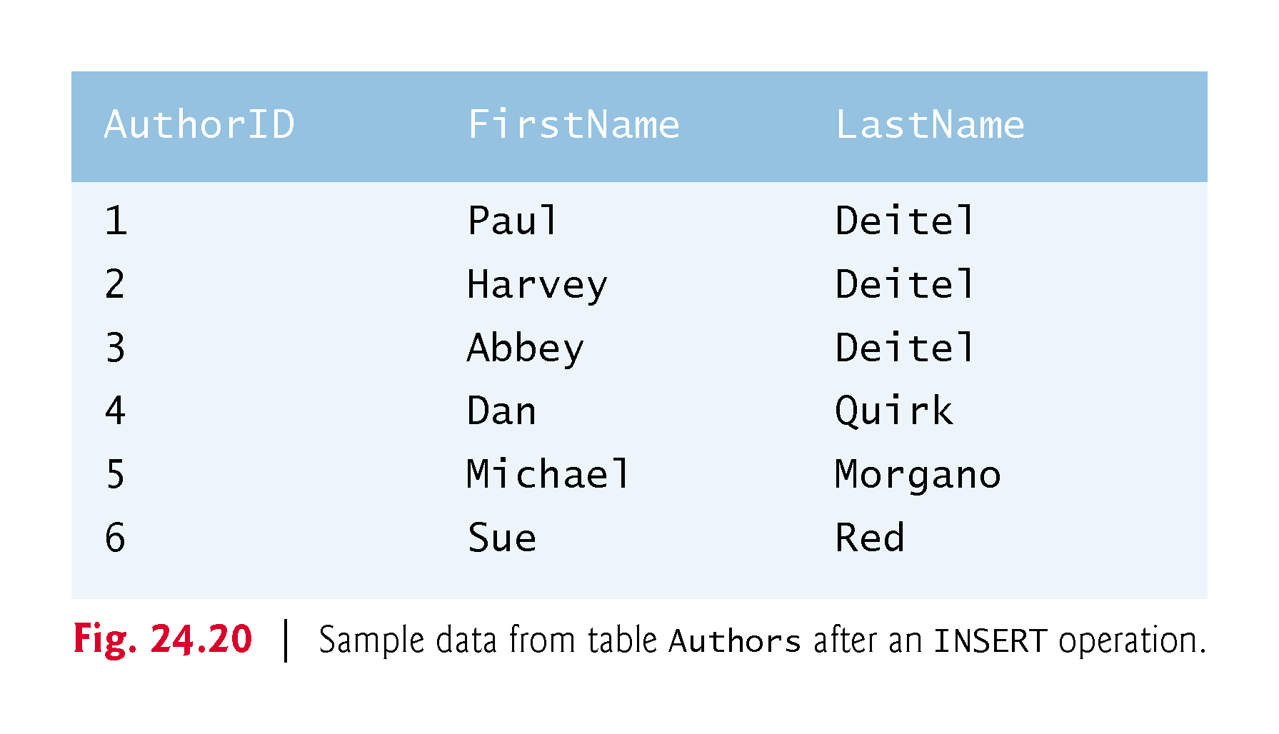

Slide 45
UPDATE Statement
An UPDATE statement modifies data in a table.
UPDATE tableName SET columnName1 = value1, columnName2 = value2, …, columnNameN = valueN WHERE criteria
where tableName is the table to update.
tableName is followed by keyword SET and a comma-separated list of columnName = value pairs.
Optional WHERE clause provides criteria that determine which rows to update.
The UPDATE statement-
UPDATE Authors SET LastName = ‘Black' WHERE LastName = ‘Red' AND FirstName = 'Sue'
indicates that LastName will be assigned the value Jones for the row where LastName is Red and FirstName is Sue.

Slide 46
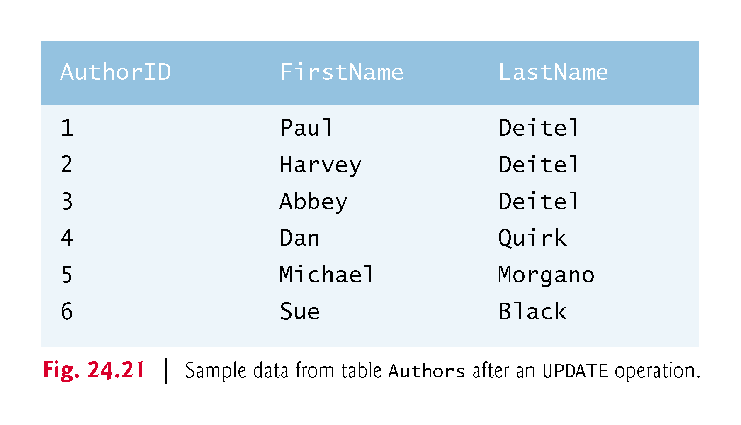

Slide 47
DELETE Statement
A SQL DELETE statement removes rows from a table.
DELETE FROM tableName WHERE criteria
where tableName is the table from which to delete.
Optional WHERE clause specifies the criteria used to determine which rows to delete.
If this clause is omitted, all the table’s rows are deleted.
The DELETE statement
DELETE FROM Authors WHERE LastName = ‘Black' AND FirstName = 'Sue'
deletes the row for Sue Jones in the Authors table.

Slide 48
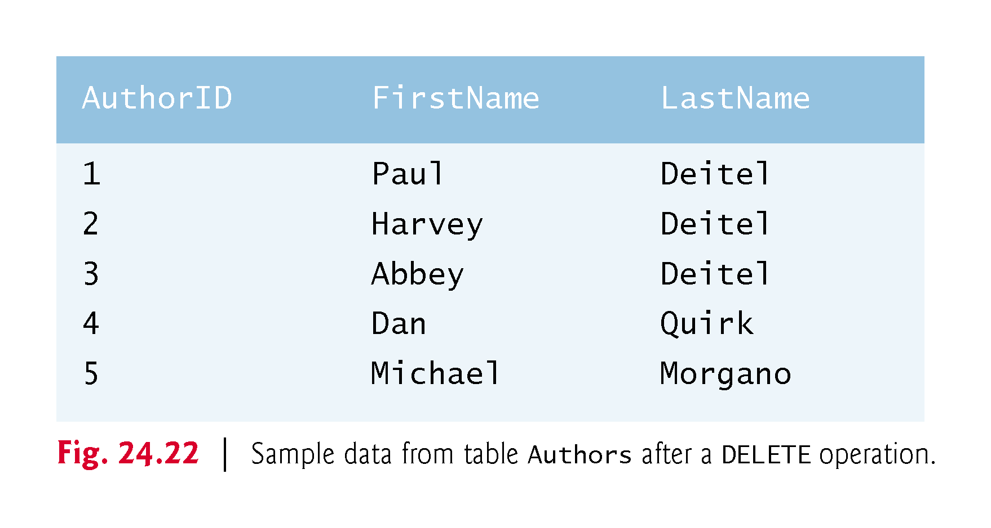

Slide 49
Connecting to and Querying a Database
The example of Fig. 24.23 illustrates connecting to the books database, querying the database and processing the result.

Slide 50
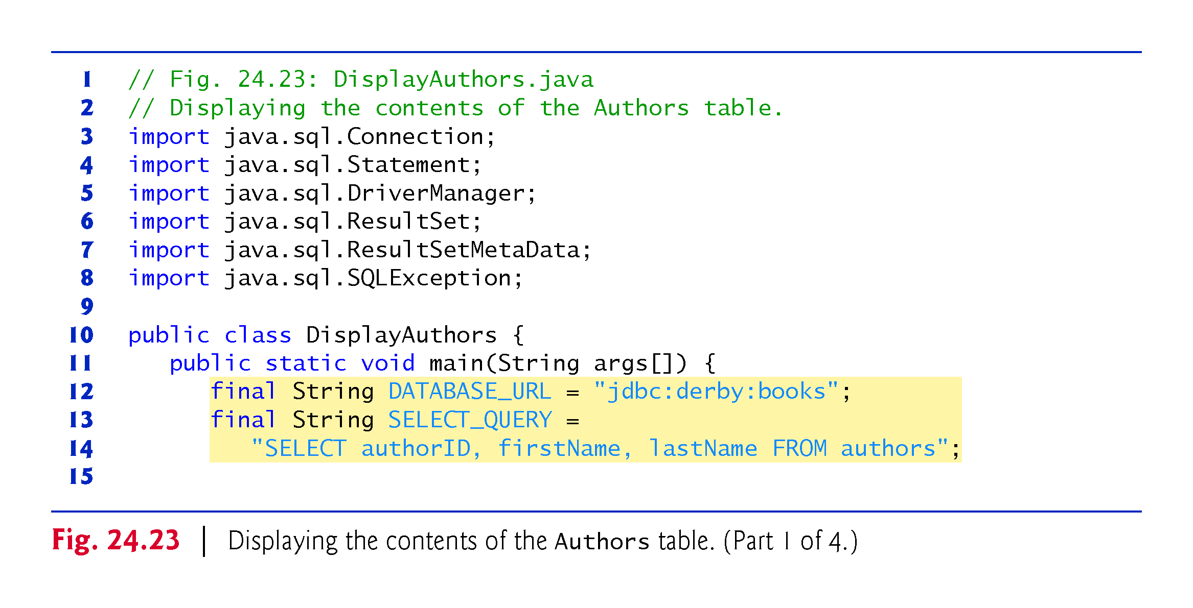

Slide 51
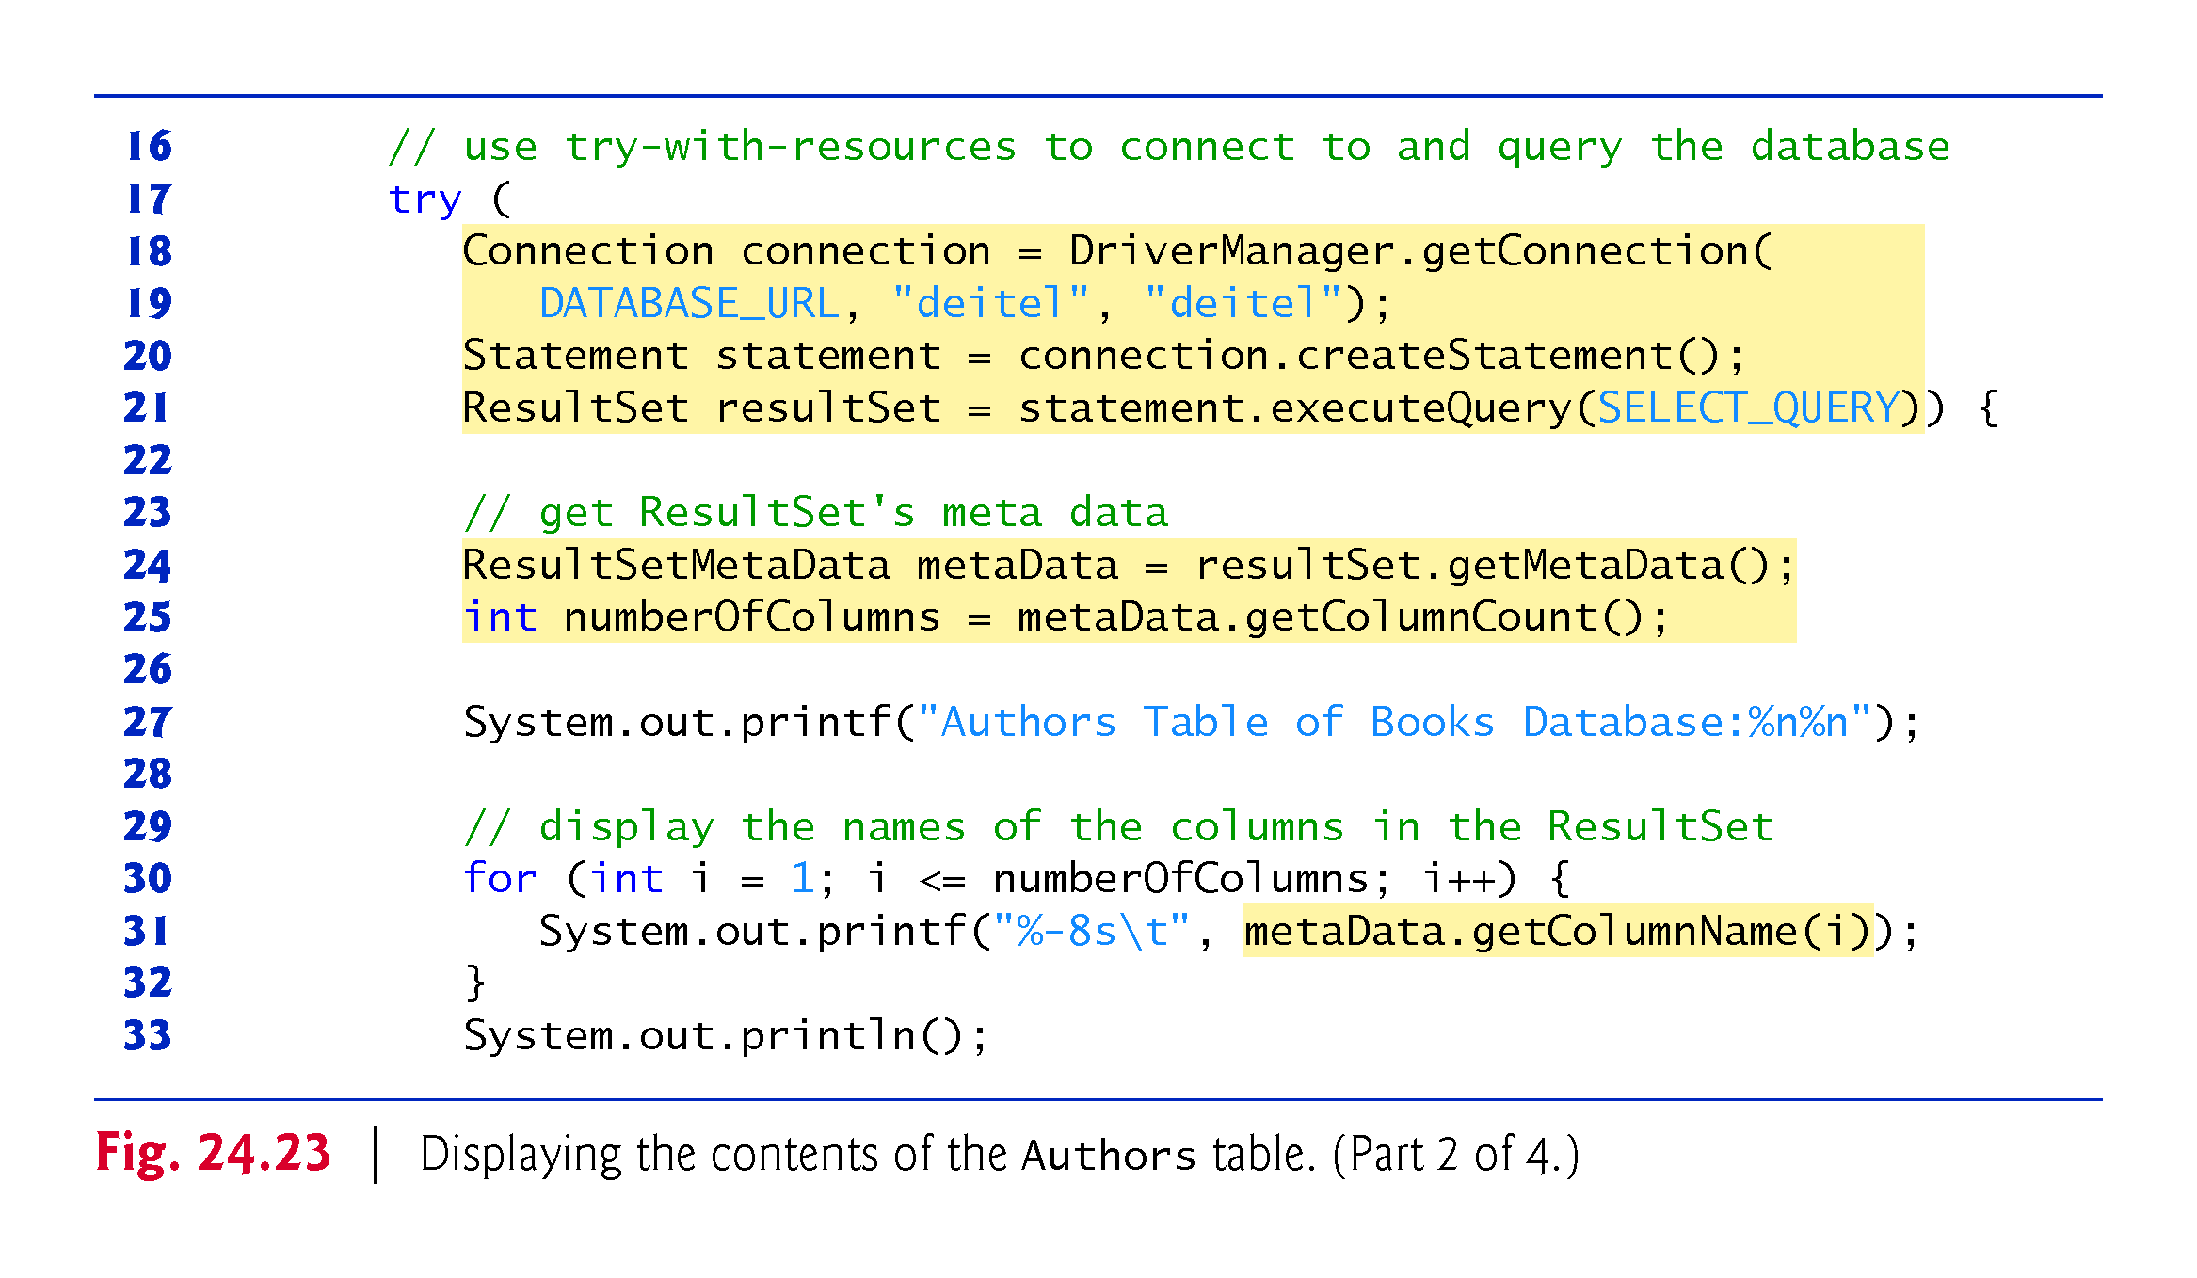

Slide 52
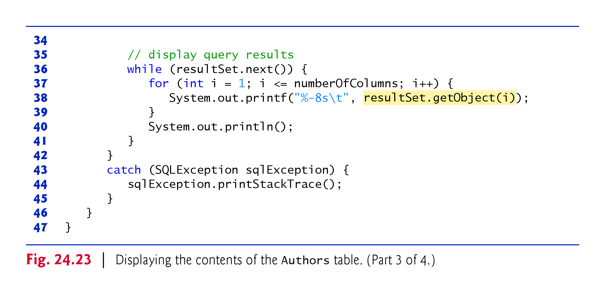

Slide 53
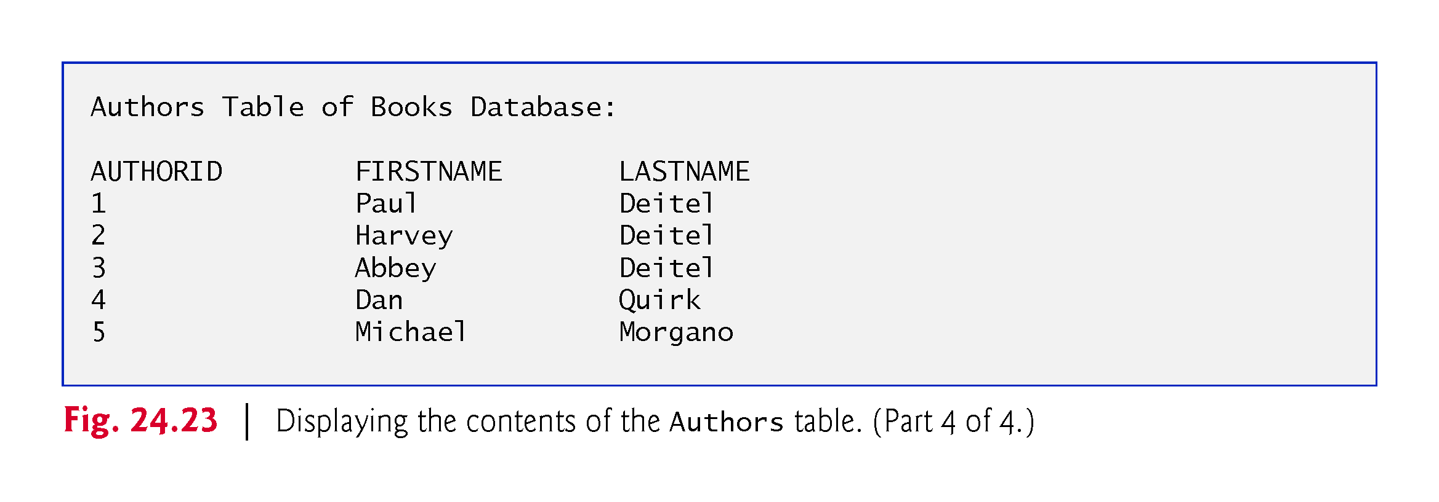

Slide 54
Automatic Driver Discovery
The database URL identifies the name of the database to connect to, as well as information about the protocol used by the JDBC driver.
JDBC supports automatic driver discovery
It loads the database driver into memory for you.
To ensure that the program can locate the database driver class, you must include the class’s location in the program’s classpath when you execute the program.

Slide 55
Connecting to the Database
Connecting to the Database
The JDBC interfaces we use in this example each extend the AutoCloseable interface, so you can use objects that implement these interfaces with the try-with-resources statement.
Each object created in the parentheses following keyword try must be separated from the next by a semicolon (;).

Slide 56
Connecting to the Database (cont.)
Connection (package java.sql)
An object that implements interface Connection manages the connection between the Java program and the database.
Connection objects enable programs to create SQL statements that manipulate databases.
The program initializes connection with the result of a call to static method getConnection of class DriverManager (package java.sql), which attempts to connect to the database specified by its URL.
Method getConnection takes three arguments
a String that specifies the database URL,
a String that specifies the username and
a String that specifies the password.

Slide 57
Connecting to the Database (cont.)
The URL jdbc:derby:books specifies
the protocol for communication (jdbc)
the subprotocol for communication (derby)
the location of the database (books).
The subprotocol derby indicates that the program uses a Java DB/Apache Derby-specific subprotocol to connect to the database.

Slide 58
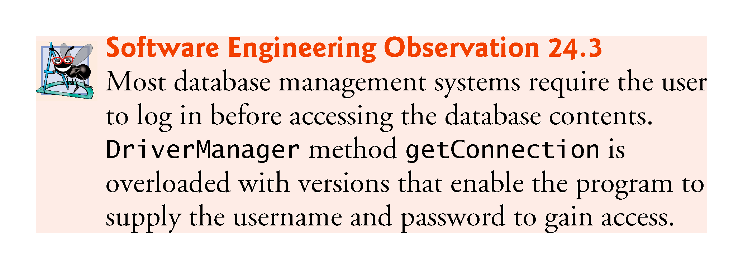

Slide 59
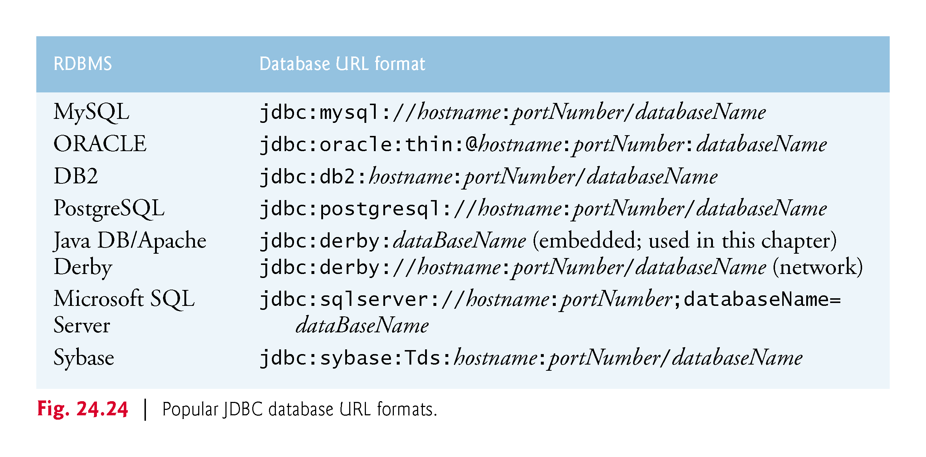

Slide 60
Creating a Statement for Executing Queries
Connection method createStatement obtains an object that implements interface Statement (package java.sql).
Used to submit SQL statements to the database.

Slide 61
Executing a Query
The Statement object’s executeQuery method submits a query to the database.
Returns an object that implements interface ResultSet and contains the query results.
The ResultSet methods enable the program to manipulate the query result.

Slide 62
Processing a Query’s ResultSet
A ResultSet’s ResultSetMetaData describes the ResultSet’s contents.
Can be used programatically to obtain information about the ResultSet’s column names and types.
ResultSetMetaData method getColumnCount retrieves the number of columns in the ResultSet.

Slide 63
Processing a Query’s ResultSet (cont.)
The first call to ResultSet method next positions the ResultSet cursor to the first row
Returns boolean value true if it is able to position to the next row; otherwise, the method returns false.
ResultSetMetaData method getColumnType returns a constant integer from class Types (package java.sql) indicating the type of a specified column.
ResultSet method getInt can be used to get the column value as an int.
ResultSet get methods typically receive as an argument either a column number (as an int) or a column name (as a String) indicating which column’s value to obtain.
ResultSet method getObject prints the Object’s String representation.

Slide 64
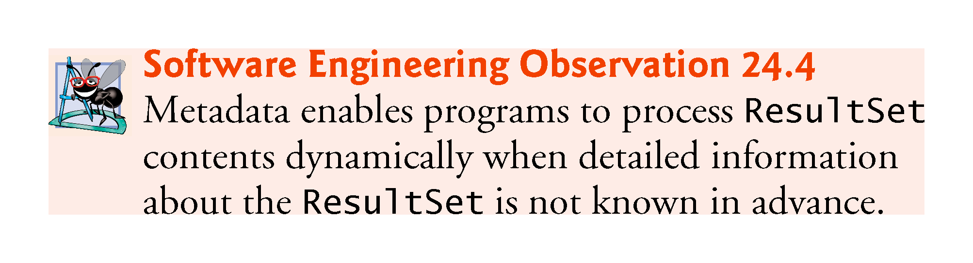

Slide 65
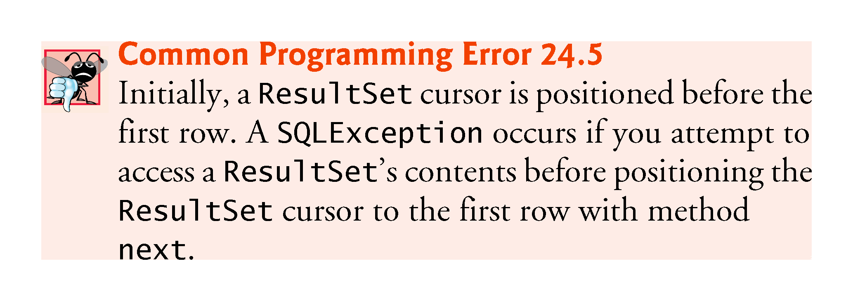

Slide 66
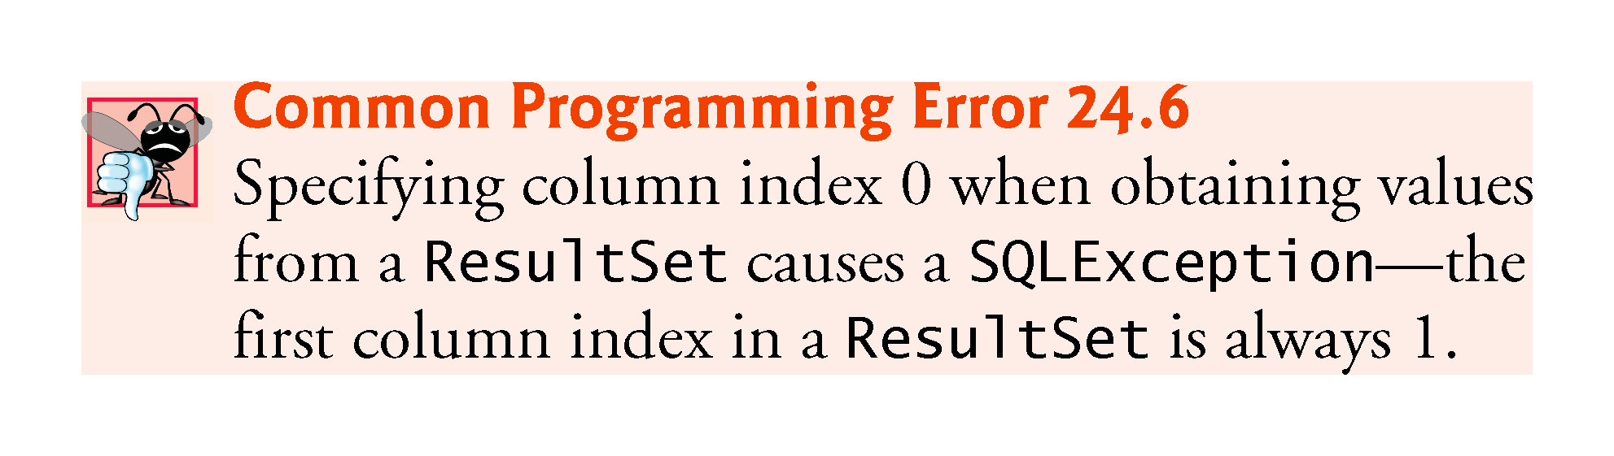

Slide 67
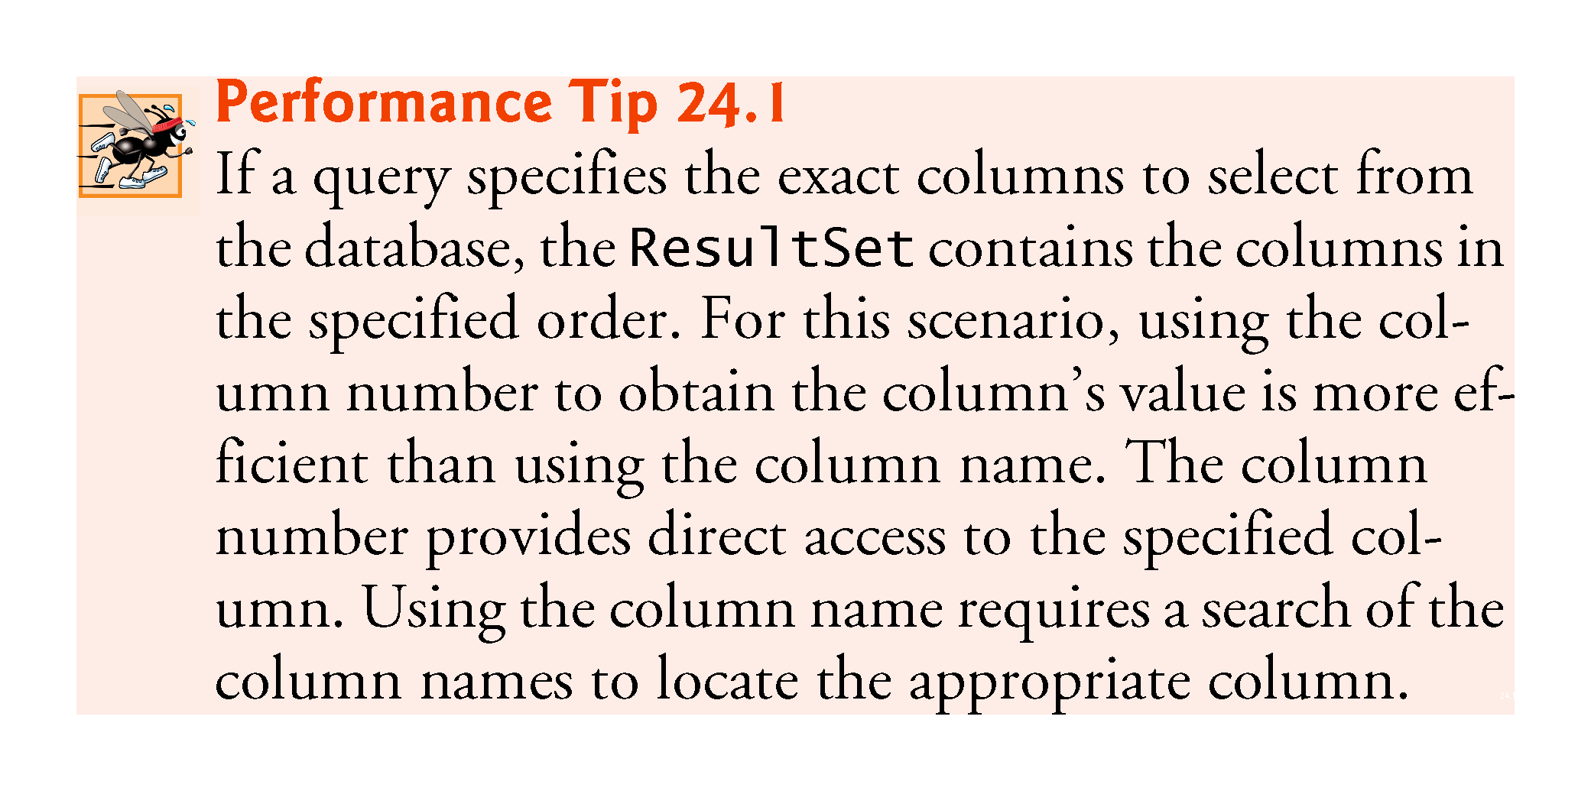

Slide 68
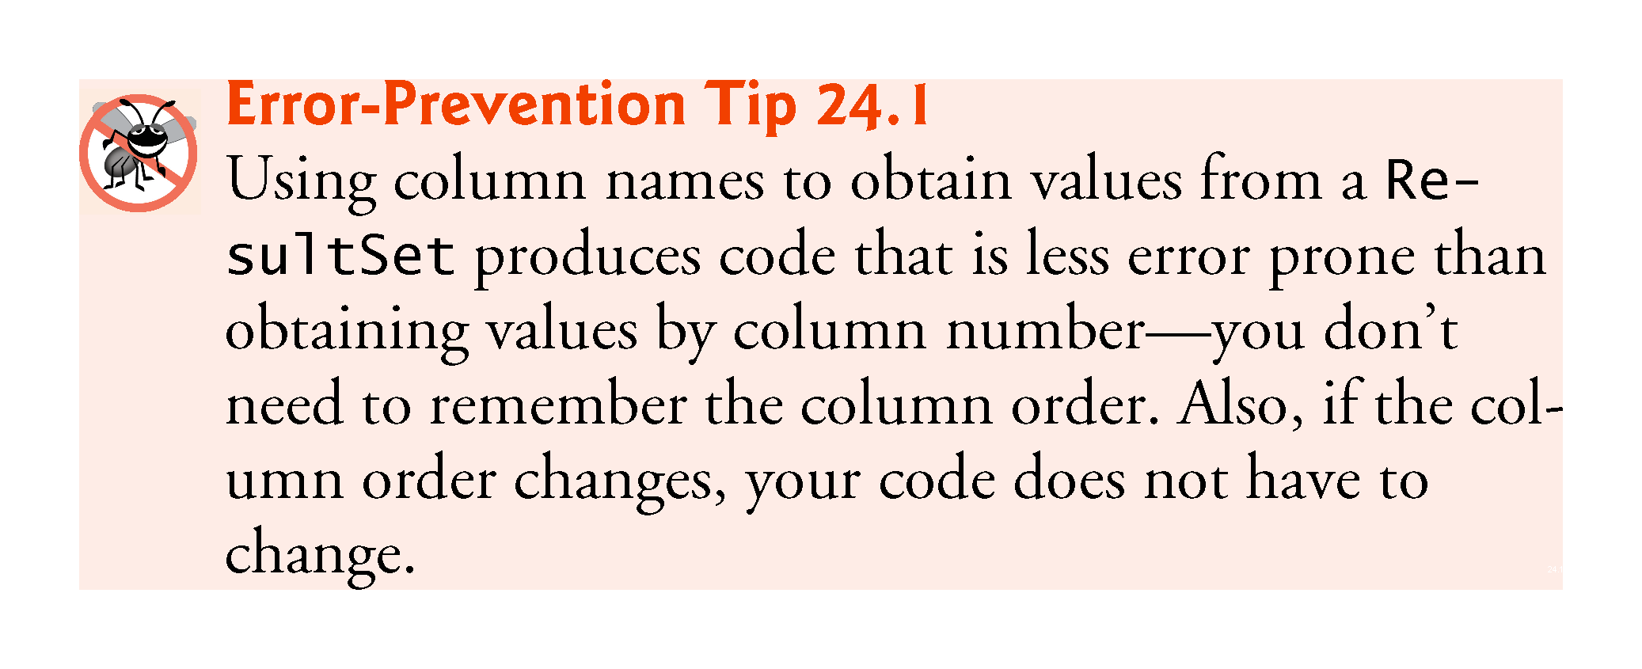

Slide 69
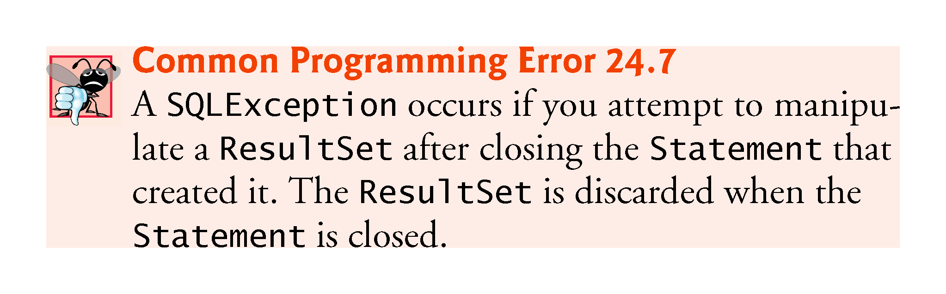

Slide 70
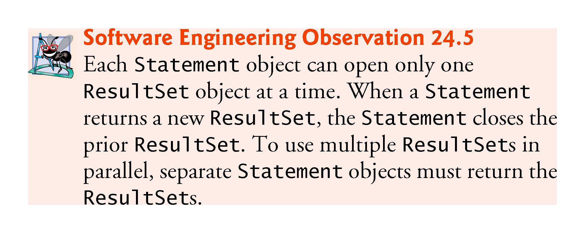

Slide 71
Querying the books Database
The next example allows the user to enter any query into the program.
Displays the result of a query in a JTable, using a TableModel object to provide the ResultSet data to the JTable.
JTable is a swing GUI component that can be bound to a database to display the results of a query.
Class ResultSetTableModel performs the connection to the database via a TableModel and maintains the ResultSet.
Class DisplayQueryResults creates the GUI and specifies an instance of class ResultSetTableModel to provide data for the JTable.

Slide 72
ResultSetTableModel Class
Class ResultSetTableModel (Fig. 24.25) is a TableModel that performs the connection to the database and maintains the ResultSet
Extends class AbstractTableModel (package javax.swing.table), which implements interface TableModel
Overrides TableModel methods getColumnClass, getColumnCount, getColumnName, getRowCount and getValueAt, based on the current ResultSet

Slide 73
ResultSetTableModel Class (cont.)
Default implementations of TableModel methods isCellEditable and setValueAt (provided by AbstractTableModel) are not overridden, because this example does not support editing the JTable cells
Default implementations of TableModel methods addTableModelListener and removeTableModelListener (provided by AbstractTableModel) are not overridden, because the AbstractTableModel implementations of these methods properly add and remove listeners for the events that occur when a TableModel changes

Slide 74
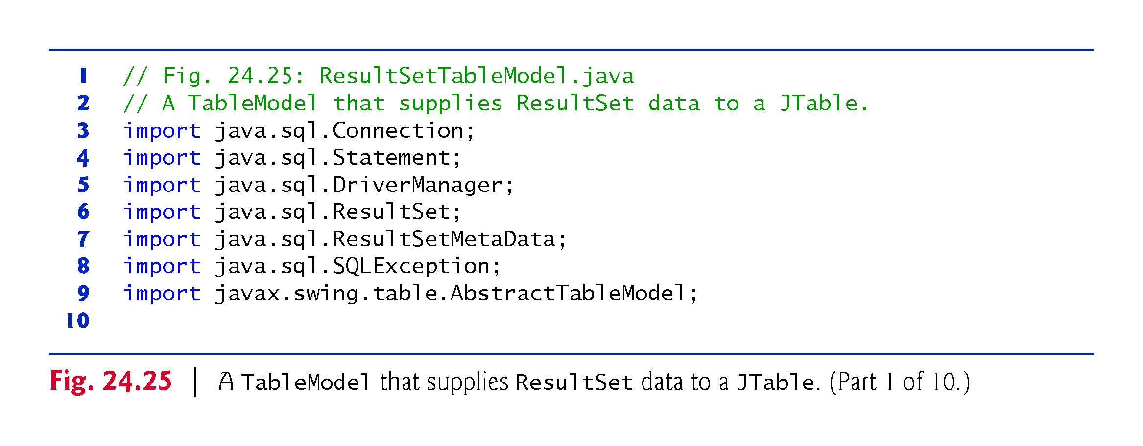

Slide 75
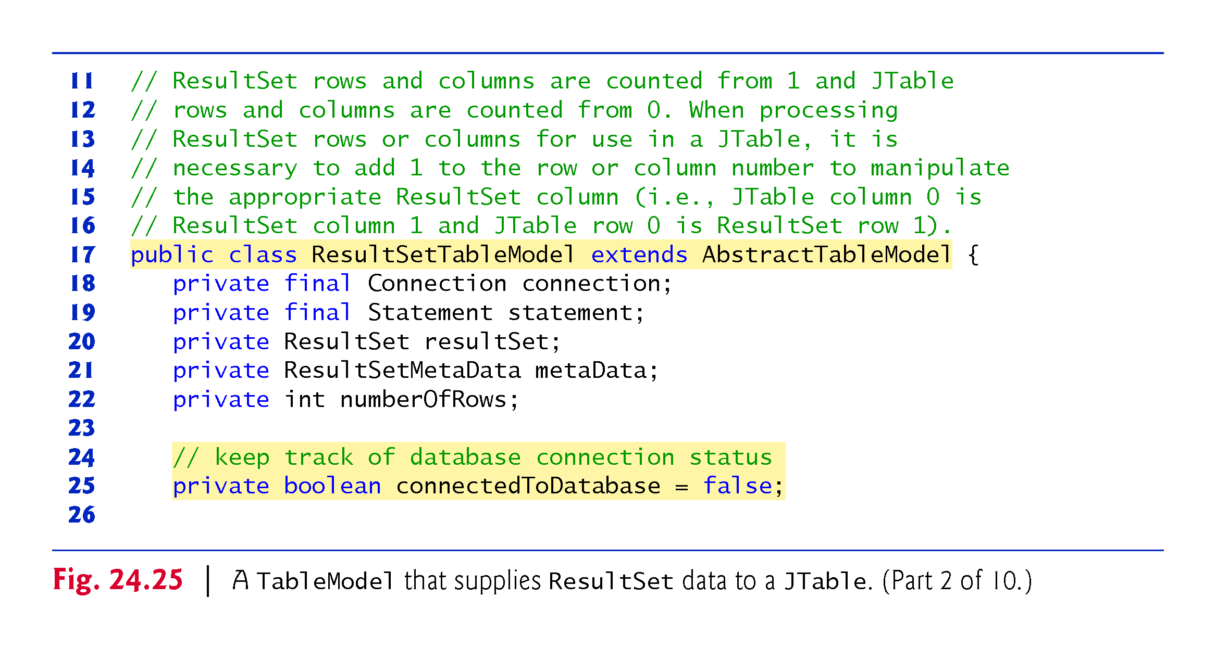

Slide 76
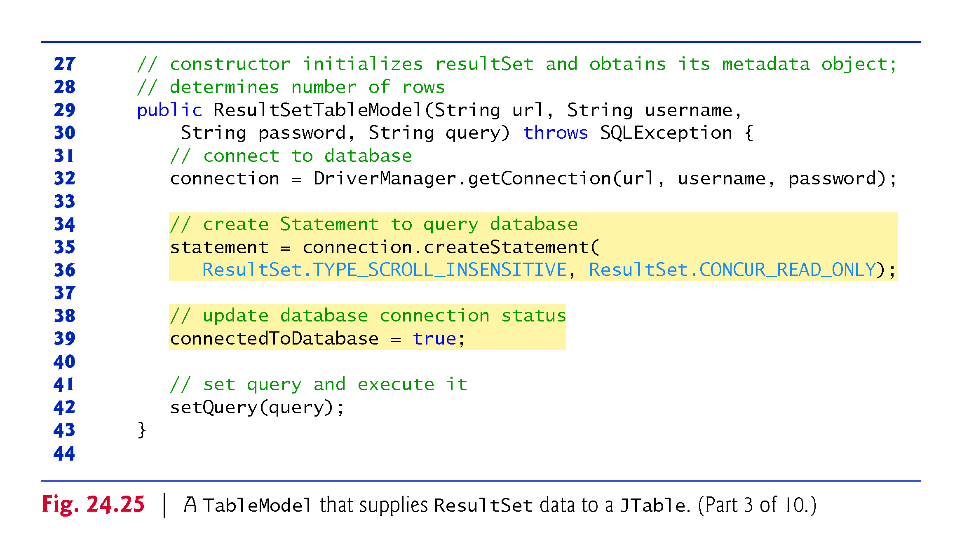

Slide 77
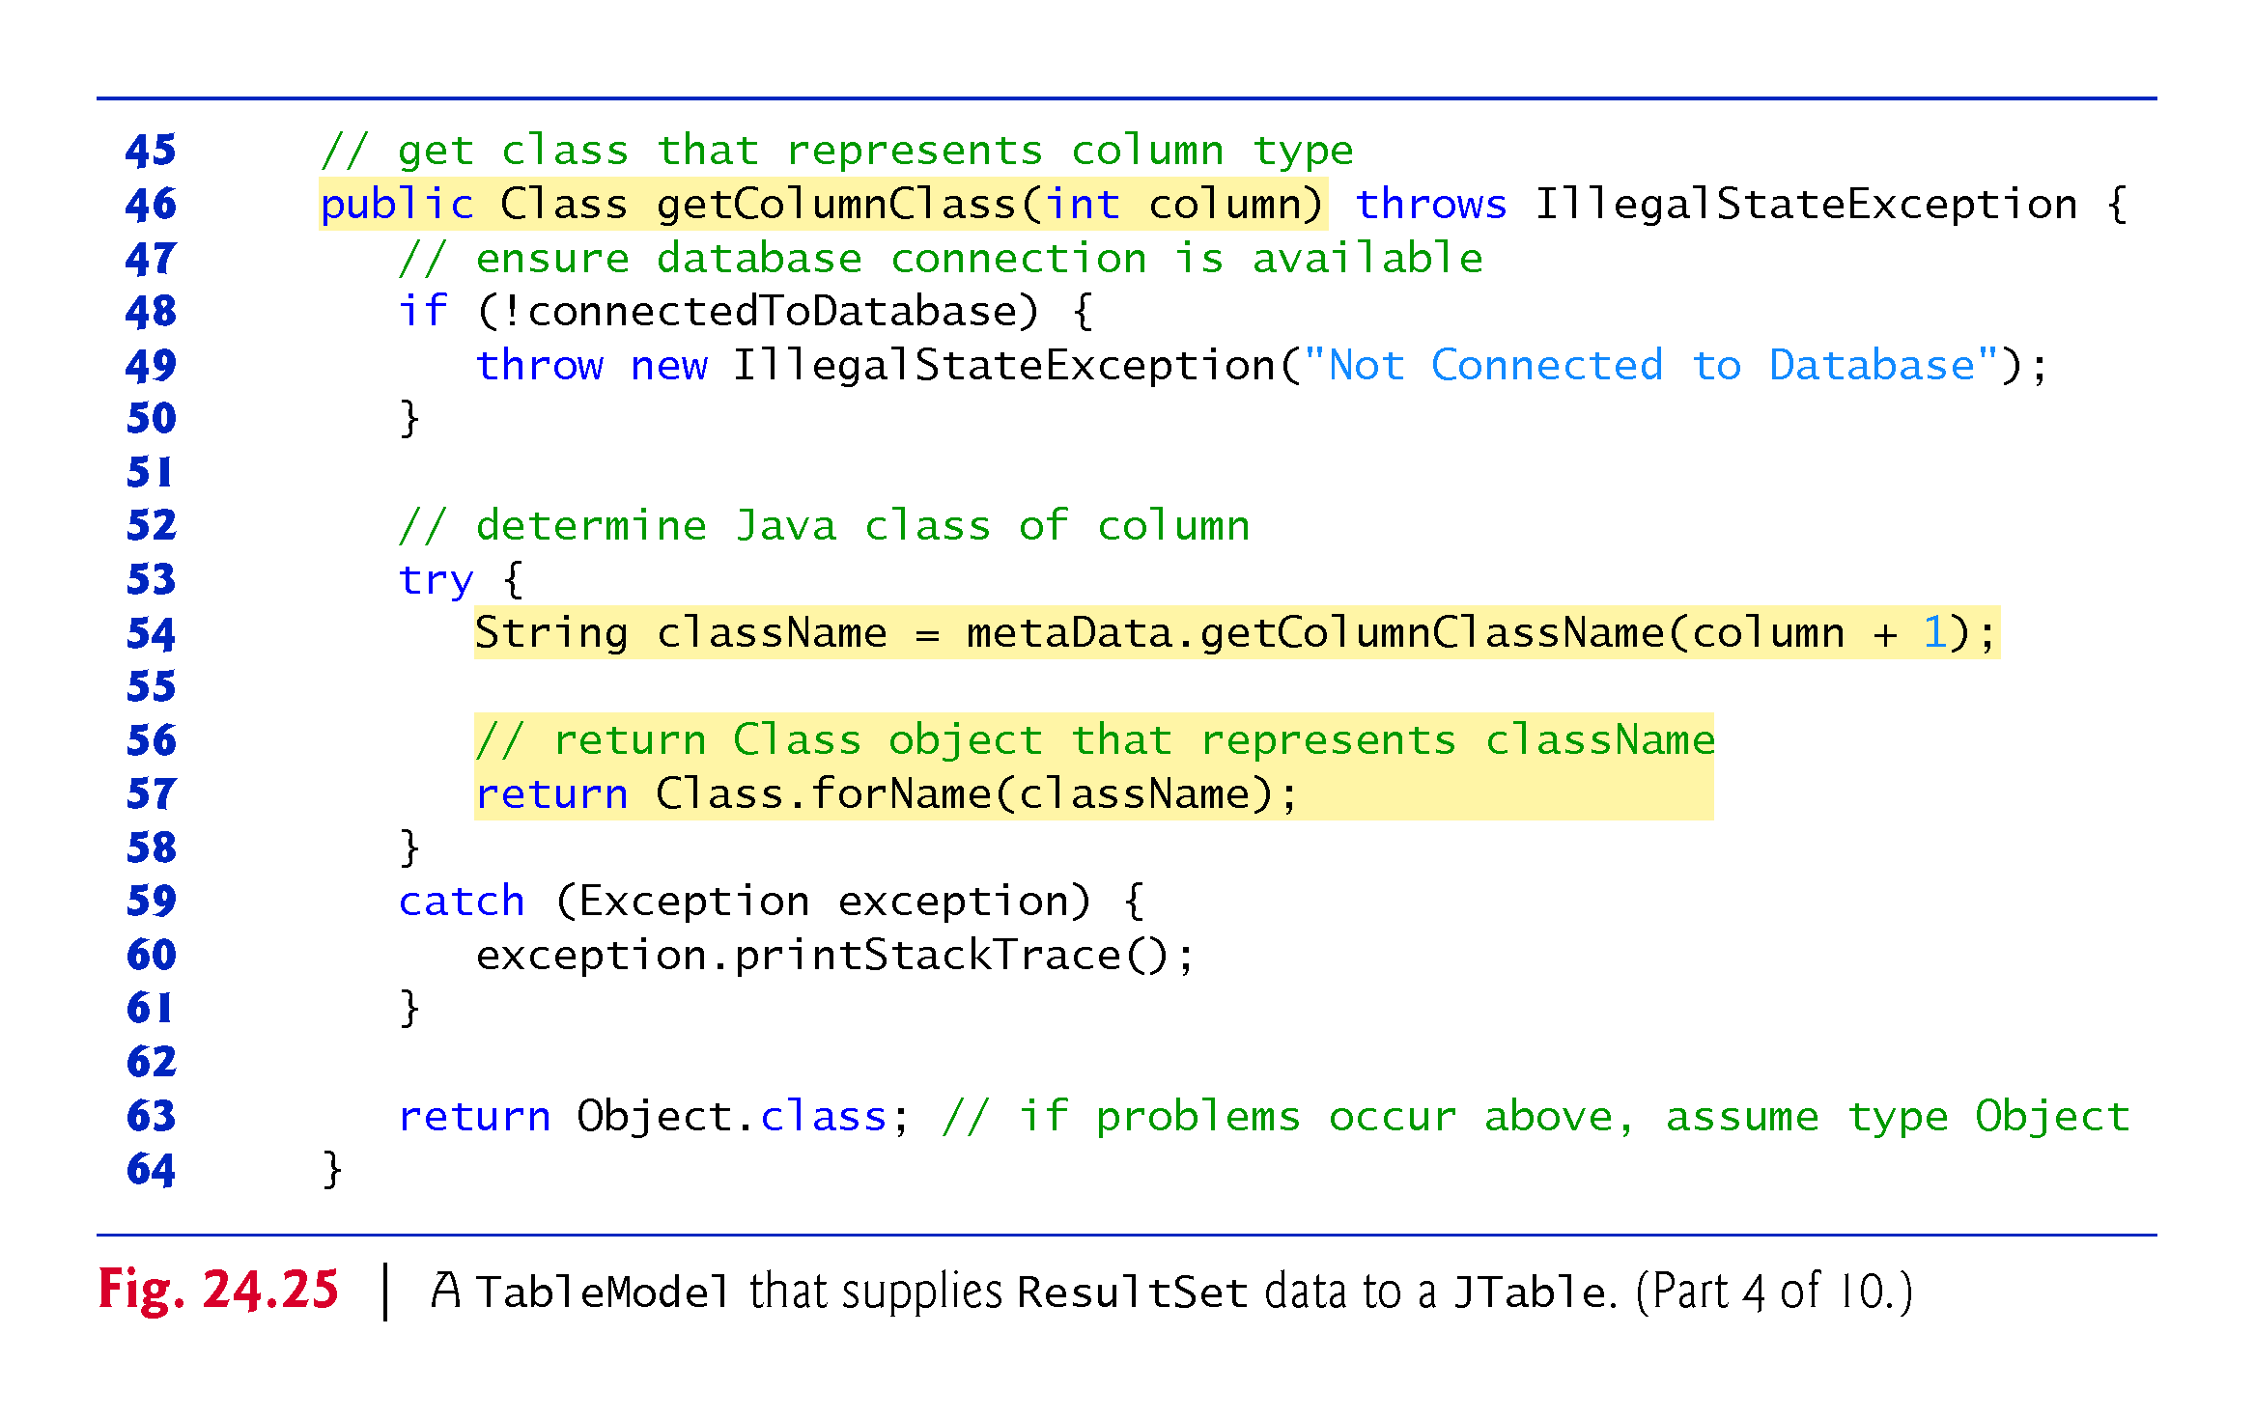

Slide 78
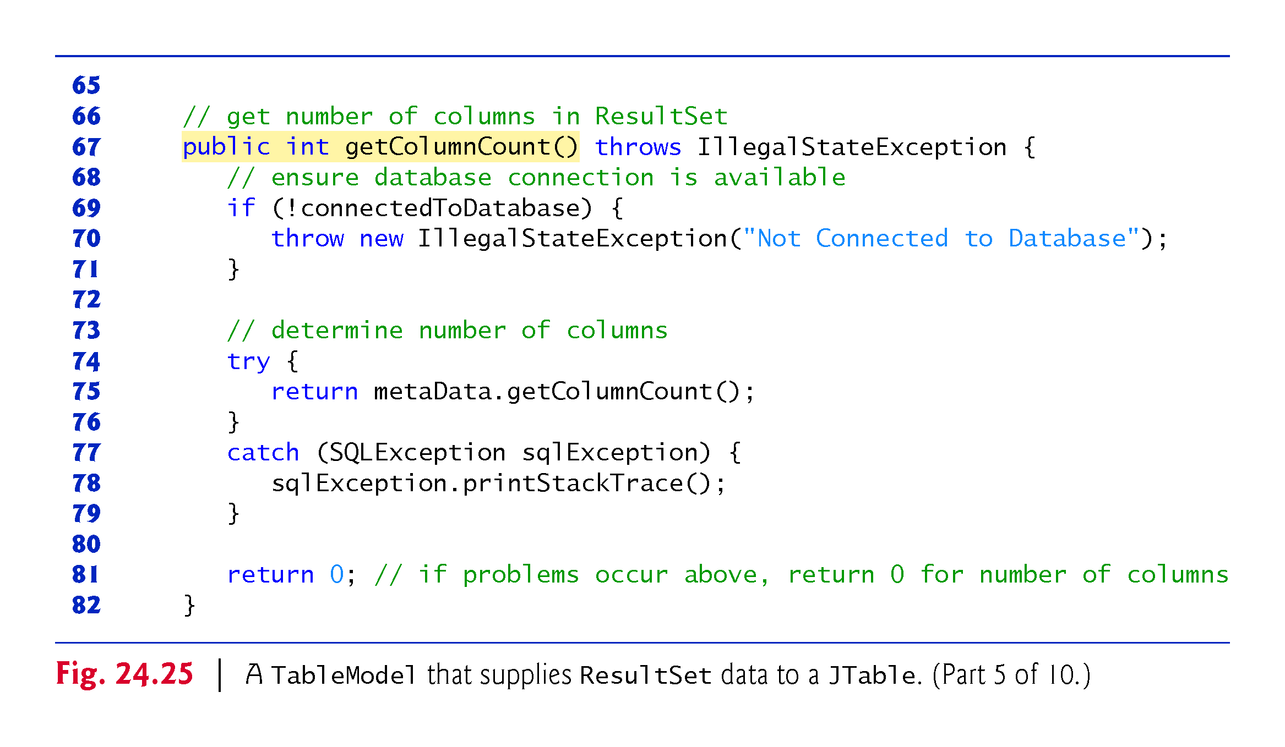

Slide 79
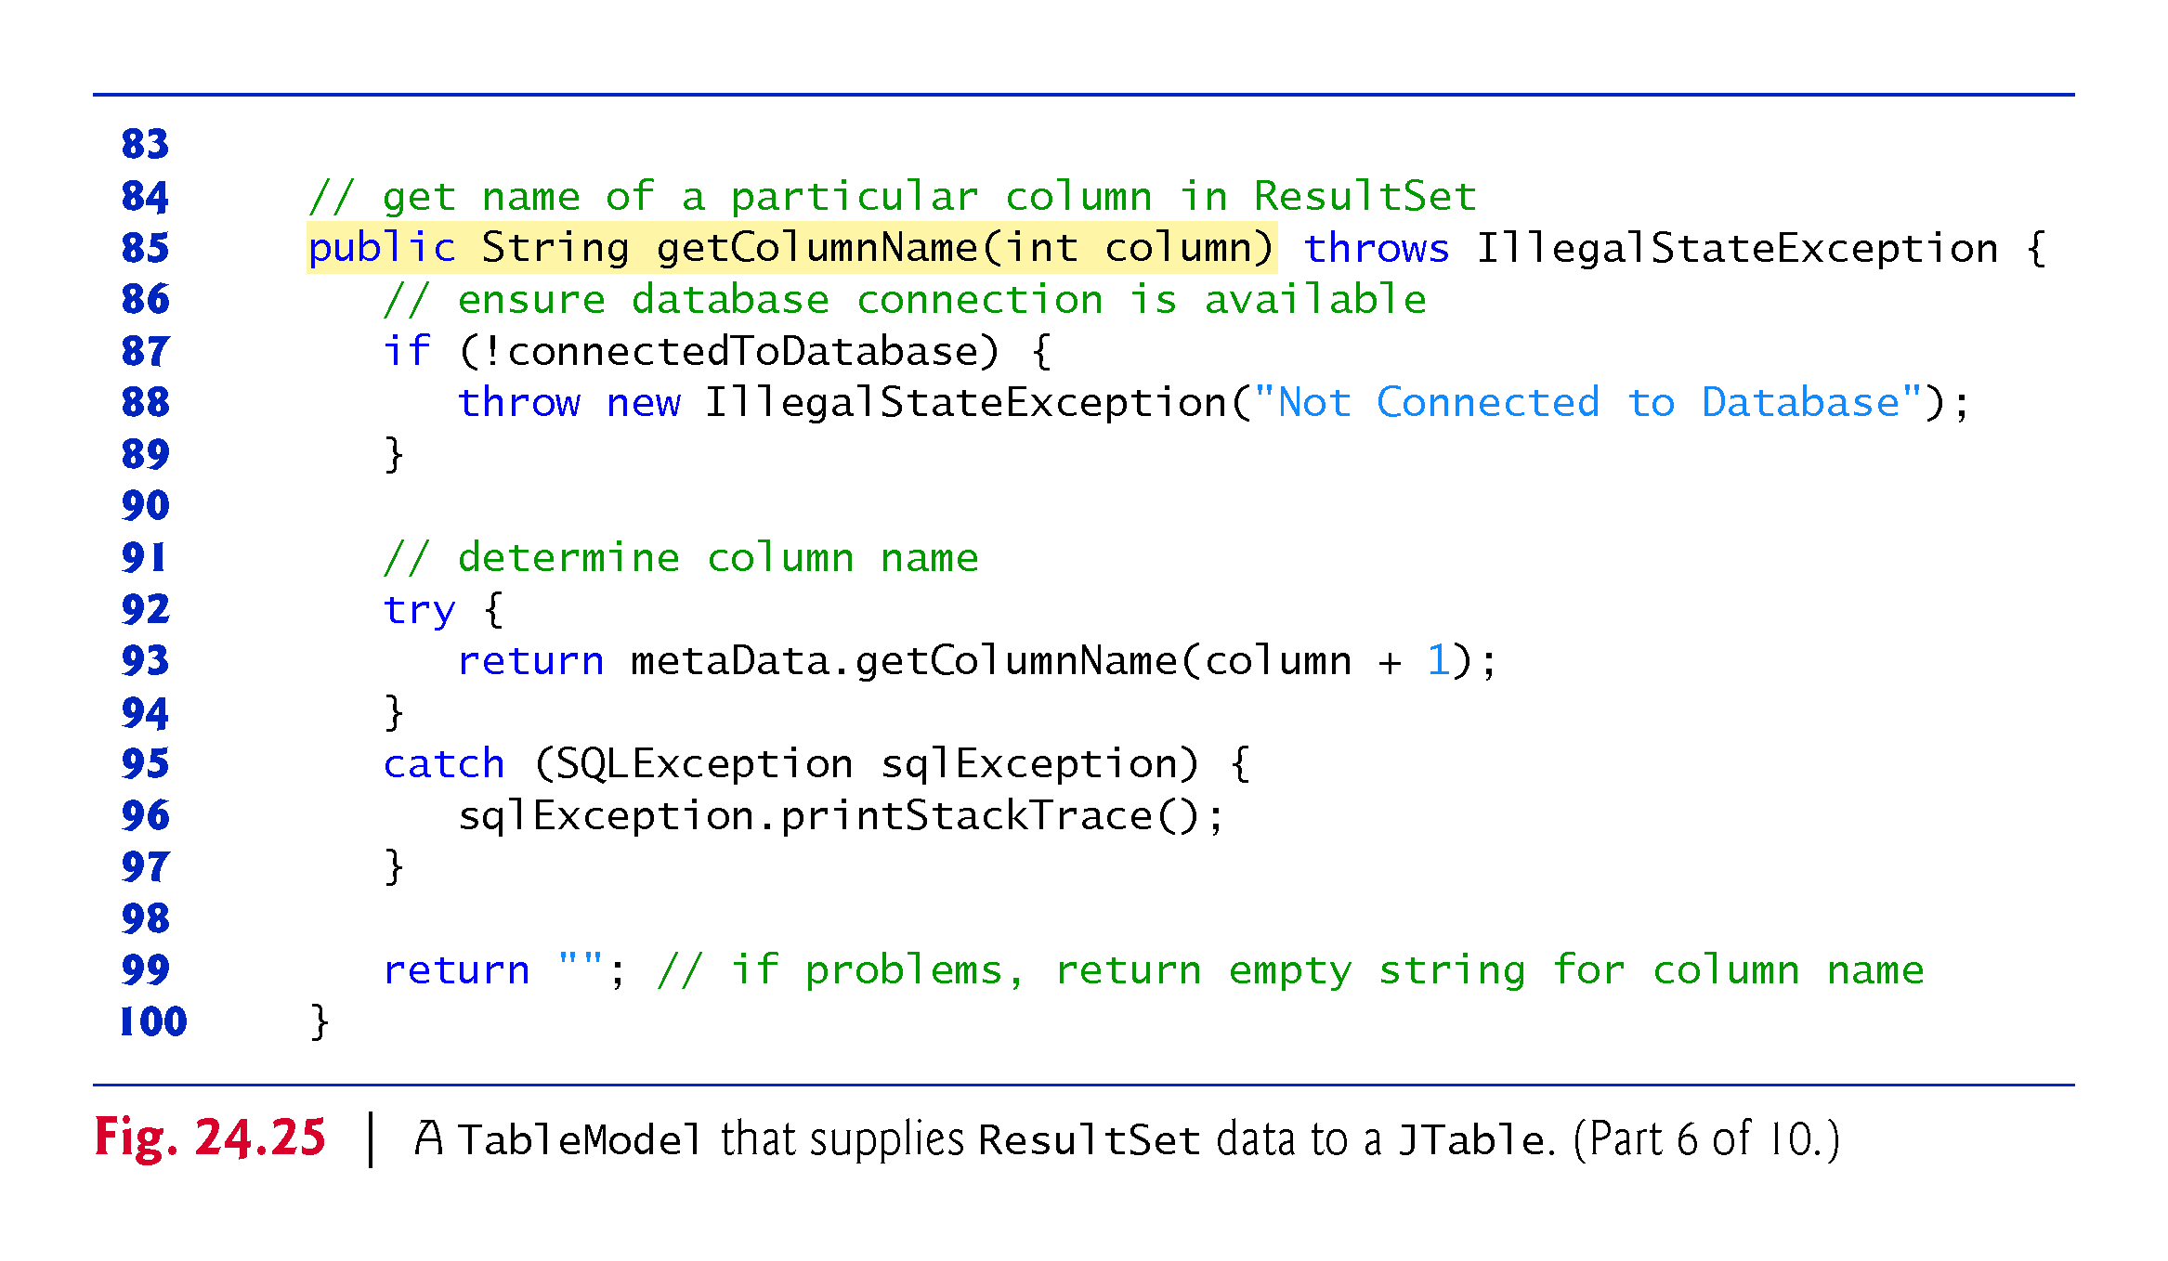

Slide 80
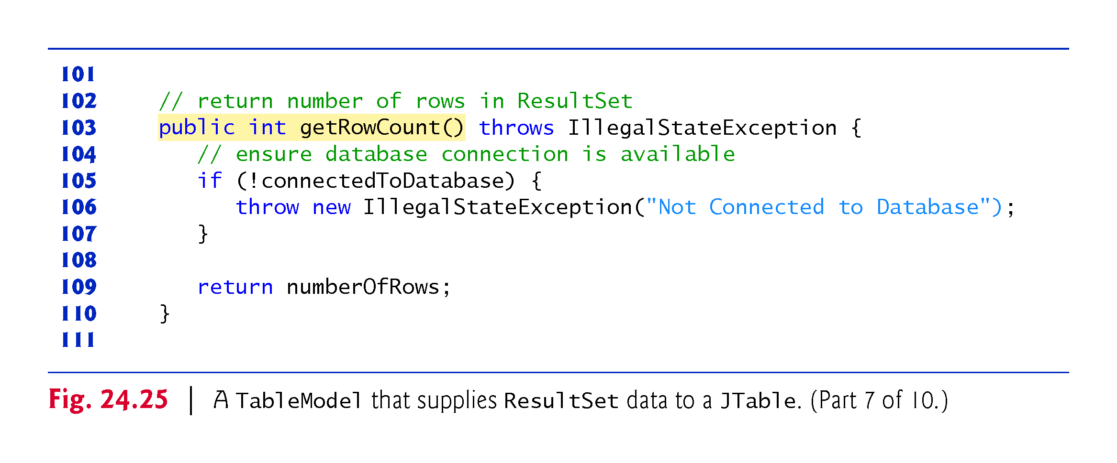

Slide 81
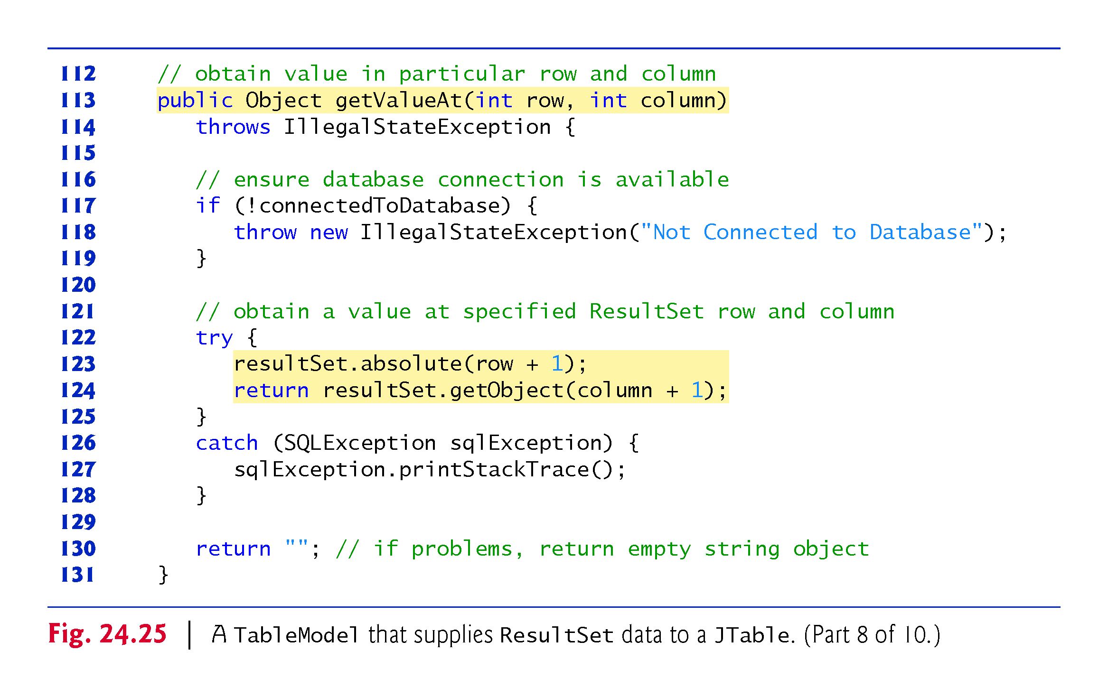

Slide 82


Slide 83


Slide 84
ResultSetTableModel Class (cont.)
ResultSetTableModel Constructor
Accepts four String arguments—the URL of the database, the username, the password and the default query to perform.
Throws any exceptions to the application that created the ResultSetTableModel
Establishes a connection to the database
Uses createStatement overload with two arguments—the result set type and the result set concurrency
The result set type (Fig. 24.26) specifies whether the ResultSet’s cursor is able to scroll in both directions or forward only and whether the ResultSet is sensitive to changes made to the underlying data.

Slide 85


Slide 86


Slide 87


Slide 88
ResultSetTableModel Class (cont.)
ResultSets that are sensitive to changes reflect those changes immediately after they’re made with methods of interface ResultSet
If a ResultSet is insensitive to changes, the query that produced the ResultSet must be executed again to reflect any changes made
The result set concurrency (Fig. 24.27) specifies whether the ResultSet can be updated with ResultSet’s update methods.
This example uses a ResultSet that is scrollable, insensitive to changes and read-only.

Slide 89


Slide 90


Slide 91


Slide 92
ResultSetTableModel Class (cont.)
ResultSetMetaData method getColumnClassName obtains the fully qualified class name for the specified column.
ResultSetMetaData method getColumnCount obtains the number of columns in the ResultSet.
ResultSetMetaData method getColumnName obtains the column name from the ResultSet.
ResultSet method absolute positions the ResultSet cursor at a specific row.
ResultSet method last positions the ResultSet cursor at the last row in the ResultSet.
ResultSet method getRow obtains the row number for the current row in the ResultSet.
Method fireTableStructureChanged (inherited from class AbstractTableModel) notifies any JTable using this ResultSetTableModel object as its model that the structure of the model has changed.
Causes the JTable to repopulate its rows and columns with the new ResultSet data.

Slide 93
DisplayQueryResultsController Class (cont.)
JTables can now show subsets of the data from the underlying TableModel.
This is known as filtering the data.
JTable method setRowFilter specifies a RowFilter (from package javax.swing) for a JTable.
RowFilter static method regexFilter receives a String containing a regular expression pattern as its argument and an optional set of indices that specify which columns to filter.
If no indices are specified, then all the columns are searched.

Slide 94
RowSet Interface
The interface RowSet provides several set methods that allow you to specify the properties needed to establish a connectionand create a Statement.
RowSet also provides several get methods that return these properties.
Two types of RowSet objects—connected and disconnected.
A connected RowSet object connects to the database once and remains connected while the object is in use.
A disconnected RowSet object connects to the database, executes a query to retrieve the data from the database and then closes the connection.
A program may change the data in a disconnected RowSet while it is disconnected.
Modified data can be updated in the database after a disconnected RowSet reestablishes the connection with the database.

Slide 95
RowSet Interface (cont.)
Package javax.sql.rowset contains two subinterfaces of RowSet—JdbcRowSet and CachedRowSet.
JdbcRowSet, a connected RowSet, acts as a wrapper around a ResultSet object and allows you to scroll through and update the rows in the ResultSet.
A JdbcRowSet object is scrollable and updatable by default.
CachedRowSet, a disconnected RowSet, caches the data of a ResultSet in memory and disconnects from the database.
A CachedRowSet object is scrollable and updatable by default.
Also serializable, so it can be passed between Java applications through a network, such as the Internet.

Slide 96


Slide 97


Slide 98


Slide 99


Slide 100


Slide 101
RowSet Interface (cont.)
Class RowSetProvider (package javax.sql.rowset) provides static method newFactory which returns a an object that implements interface RowSetFactory (package javax.sql.rowset) that can be used to create various types of RowSets.
The try-with-resources statement use RowSetFactory method createJdbcRowSet to obtain a JdbcRowSet object.
JdbcRowSet method setUrl specifies the database URL.
JdbcRowSet method setUsername specifies the username.
JdbcRowSet method setPassword specifies the password.
Jdbc-RowSet method setCommand specifies the SQL query that will be used to populate the RowSet.

Slide 102
RowSet Interface (cont.)
JdbcRowSet method execute executes the SQL query.
Method execute performs four actions
Establishes a Connection to the database
Prepares the query Statement
Executes the query
Stores the ResultSet returned by query.
The Connection, Statement and ResultSet are encapsulated in the JdbcRowSet object.
JdbcRowSet method close closes the RowSet’s encapsulated ResultSet, Statement and Connection.

Slide 103
PreparedStatements
Interface PreparedStatement enables you to create compiled SQL statements that execute more efficiently than Statement objects.
Can also specify parameters, making them more flexible than Statements.
Programs can execute the same query repeatedly with different parameter values.

Slide 104
PreparedStatements (cont.)
To locate all book titles for an author with a specific last name and first name:
PreparedStatement authorBooks = connection.prepareStatement( "SELECT LastName, FirstName, Title " + "FROM Authors INNER JOIN AuthorISBN " + "ON Authors.AuthorID=AuthorISBN.AuthorID " + "INNER JOIN Titles " + "ON AuthorISBN.ISBN=Titles.ISBN " + "WHERE LastName = ? AND FirstName = ?" );
The two question marks (?) are placeholders for values that will be passed as part of the query to the database.

Slide 105
PreparedStatements (cont.)
Before executing a PreparedStatement, the program must specify the parameter values by using the PreparedStatement interface’s set methods.
For the preceding query, both parameters are strings that can be set with PreparedStatement method setString as follows:
authorBooks.setString( 1, "Deitel" ); authorBooks.setString( 2, "Paul" );
Parameter numbers are counted from 1, starting with the first question mark (?).
Interface PreparedStatement provides set methods for each supported SQL type.

Slide 106


Slide 107


Slide 108


Slide 109
PreparedStatements (cont.)
Our addressbook Java DB database contains an Addresses table with the columns AddressID, FirstName, LastName, Email and PhoneNumber.
The column AddressID is an identity column in the Addresses table.

Slide 110


Slide 111


Slide 112


Slide 113


Slide 114


Slide 115


Slide 116


Slide 117


Slide 118


Slide 119


Slide 120


Slide 121


Slide 122
PreparedStatements (cont.)
Invoke Connection method prepareStatement to create a PreparedStatement.
Calling PreparedStatement method executeQuery returns a ResultSet containing the rows that match the query.
PreparedStatement method executeUpdate executes a SQL statement that modifies the database.

Slide 123
Stored Procedures
Many database management systems can store individual SQL statements or sets of SQL statements in a database, so that programs accessing that database can invoke them.
Such named collections of SQL statements are called stored procedures.
JDBC enables programs to invoke stored procedures using objects that implement the interface CallableStatement.
In addition, CallableStatements can specify output parameters in which a stored procedure can place return values.
The interface also includes methods to obtain the values of output parameters returned from a stored procedure.
To learn more about CallableStatements, visit
java.sun.com/javase/6/docs/technotes/guides/jdbc/getstart/ callablestatement.html#999652

Slide 124


Slide 125


Slide 126
Transaction Processing
Many database applications require guarantees that a series of database insertions, updates and deletions executes properly before the applications continue processing the next database operation.
Transaction processing enables a program that interacts with a database to treat a database operation (or set of operations) as a single operation.
Such an operation also is known as an atomic operation or a transaction.
At the end of a transaction, a decision can be made either to commit the transaction or roll back the transaction.
Committing the transaction finalizes the database operation(s).
Rolling back the transaction leaves the database in its state prior to the database operation.

Slide 127
Transaction Processing (cont.)
Connection method setAutoCommit specifies whether each SQL statement commits after it completes (a true argument) or whether several SQL statements should be grouped as a transaction (a false argument).
If the argument to setAutoCommit is false, the program must follow the last SQL statement in the transaction with a call to Connection method commit or Connection method rollback.
Interface Connection also provides method getAutoCommit to determine the autocommit state for the Connection.

